Slide 1
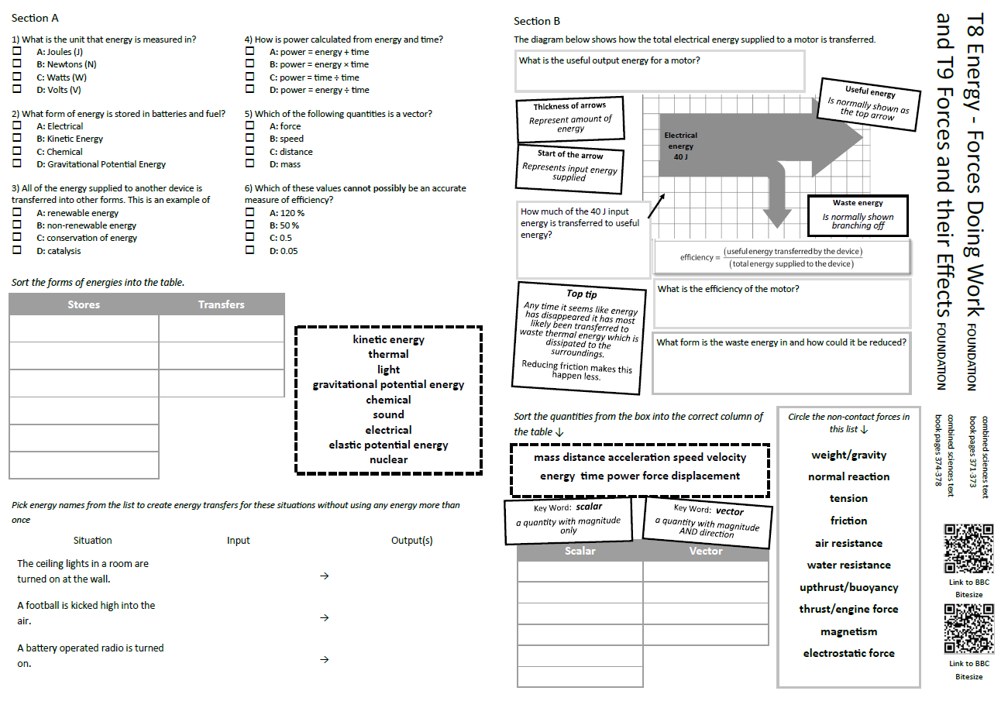
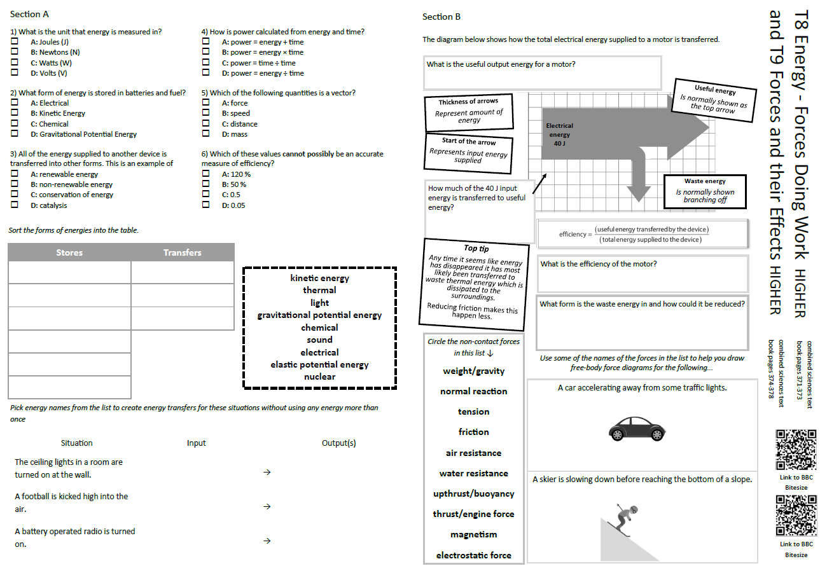
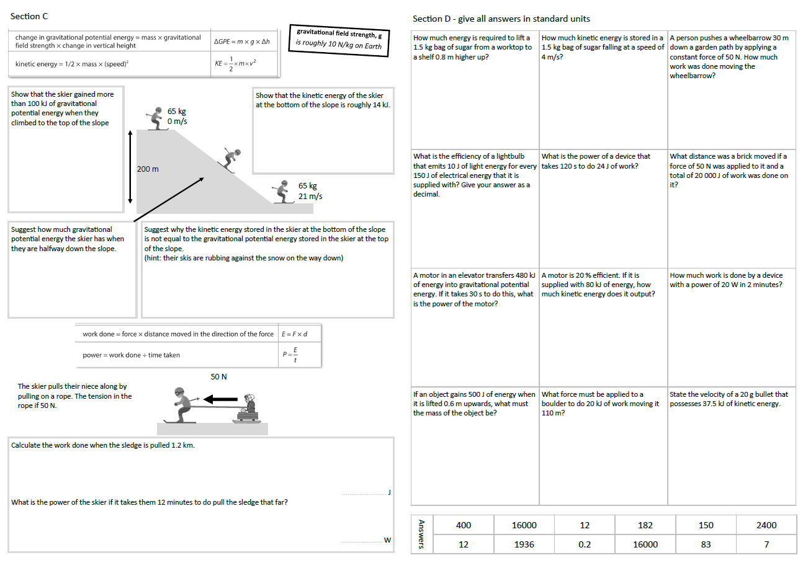
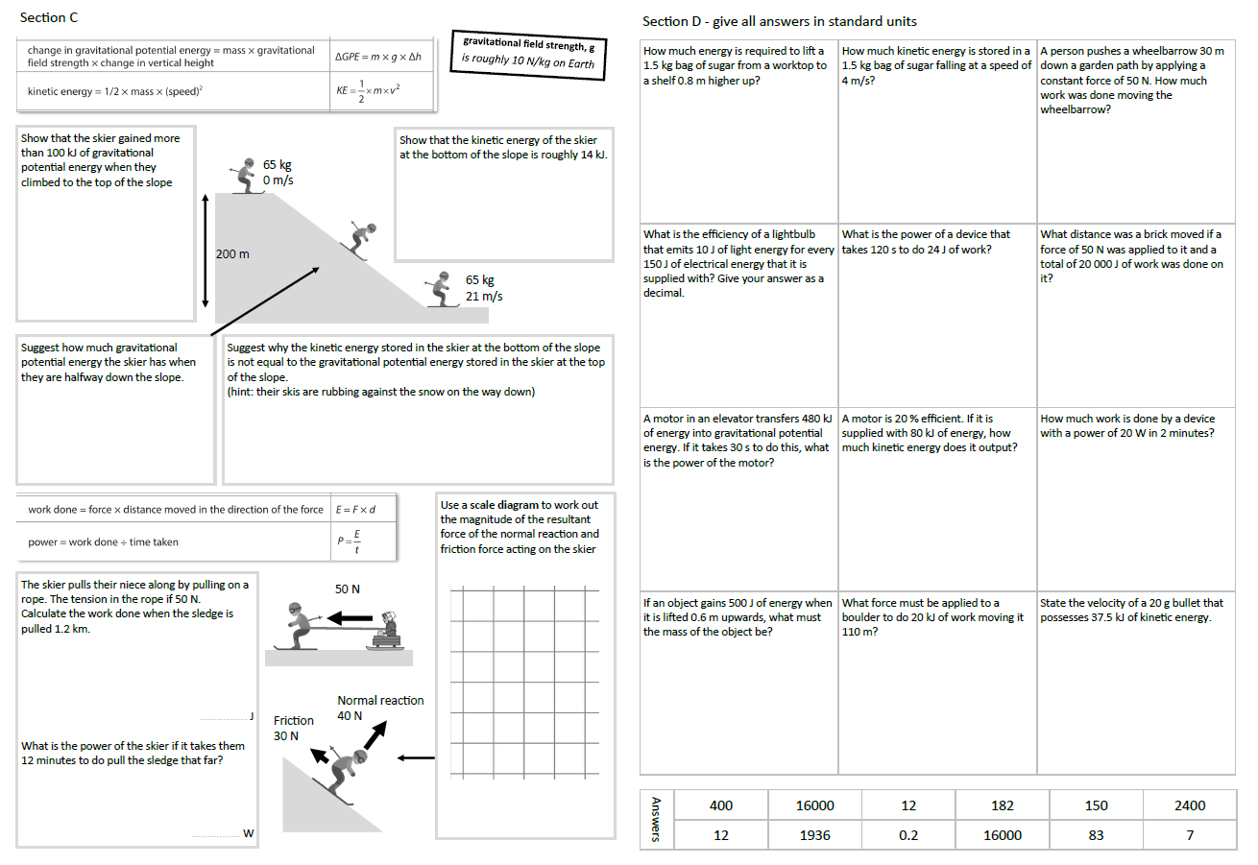
GCSE Physics Revision
Review Topic 8 and 9
Forces doing work, Forces and their effects
Learning Outcomes
Identify core knowledge gaps within the topic.
Practise using equations related to the topic.
Collect an A3 revision mat (←foundation or higher→)
Both sets of answers are found on these slides.
And fill in as much of section A and section B as you can.

Slide 2
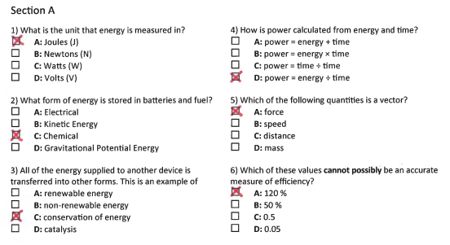
Section A
Collect an A3 revision mat (higher or foundation)
And fill in as much of section A and section B as you can.
Section B
A typical calculation from this topic
Section C
Section D
Extension task: Past paper
Click again to show answers to section A multiple choice
Click again to show answers to section bottom half

Slide 3

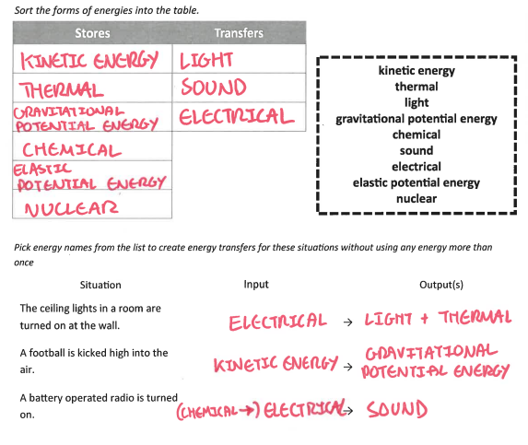
Section A
Fill in as much of section A and section B as you can.
Section B
A typical calculation from this topic
Section C
Section D
Extension task: Past paper
Click again to show answers to section B top half

Slide 4
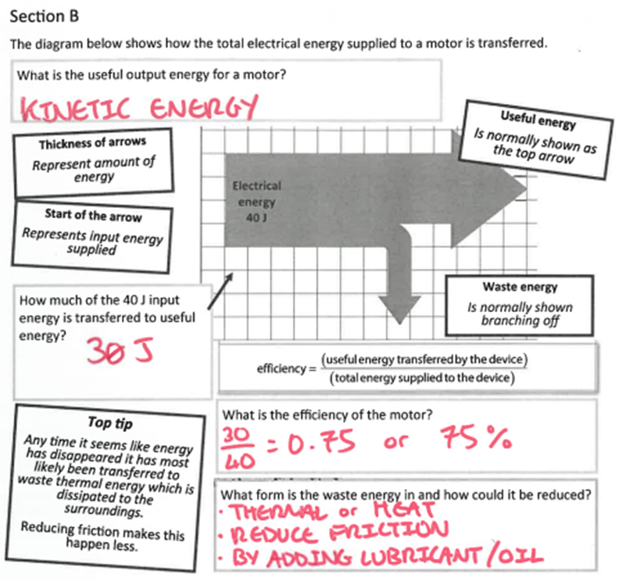
Section A
Fill in as much of section A and section B as you can.
Section B
A typical calculation from this topic
Section C
Section D
Extension task: Past paper
Click again to show answers to section B bottom half

Slide 5
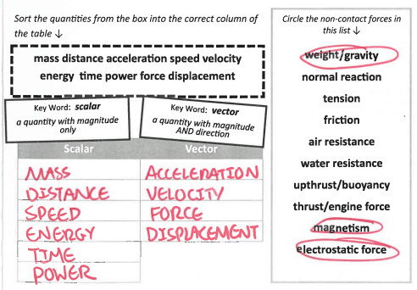
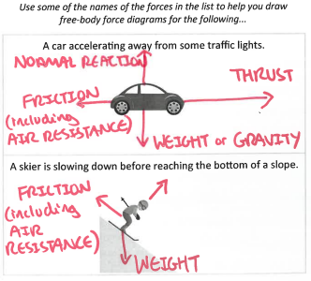
Section A
Foundation
Higher
Section B
A typical calculation from this topic
Section C
Section D
Extension task: Past paper
Click again to show higher section B

Slide 6
Section A
Section B
How much work is done by a ski-lift motor if it has a power rating of 7.5 kW and has been running for three hours?
use power = energy transferred ÷ time
(3 marks)
A typical calculation from this topic
Section C
Section D
Extension task: Past paper
work done ……………………… kJ
Click again to show model answer

Slide 7
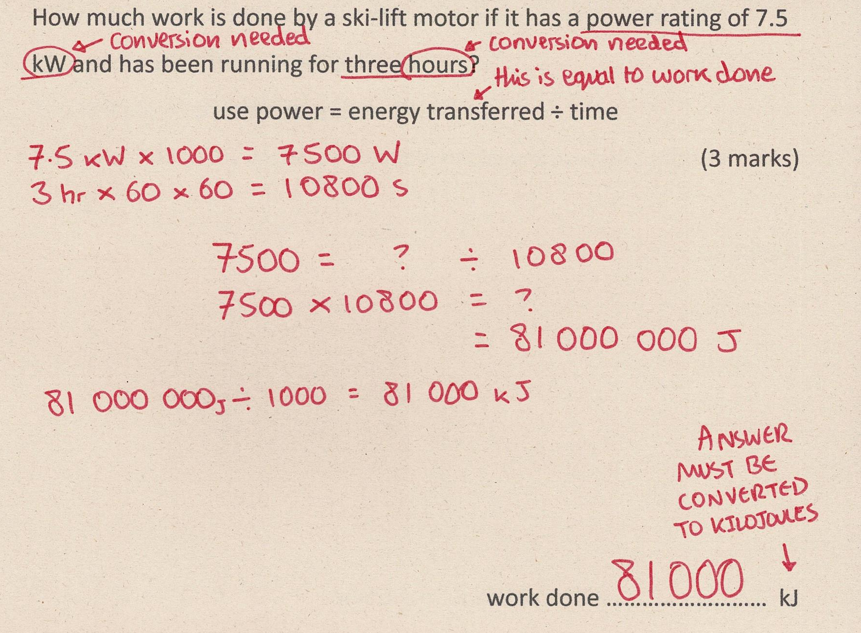
Section A
Fill in as much of section C and section D as you can.
Section B
A typical calculation from this topic
Section C
Section D
Extension task: Past paper
Click again to show answers to section C top half

Slide 8
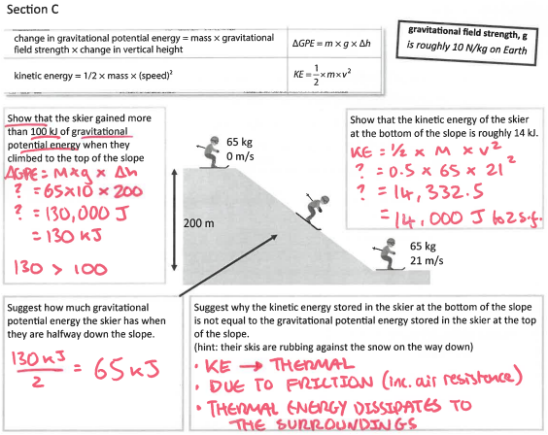
Section A
Fill in as much of section C and section D as you can.
Section B
A typical calculation from this topic
Section C
Section D
Extension task: Past paper
Click again to show answers to section C top half

Slide 9
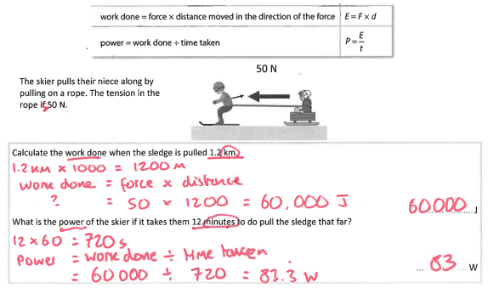
Section A
Fill in as much of section C and section D as you can.
Section B
A typical calculation from this topic
Section C
Section D
Extension task: Past paper
Click again for top of section D

Slide 10
Section A
MISSING ANSWERS
Section B
A typical calculation from this topic
Section C
Section D
Extension task: Past paper

