Slide 1
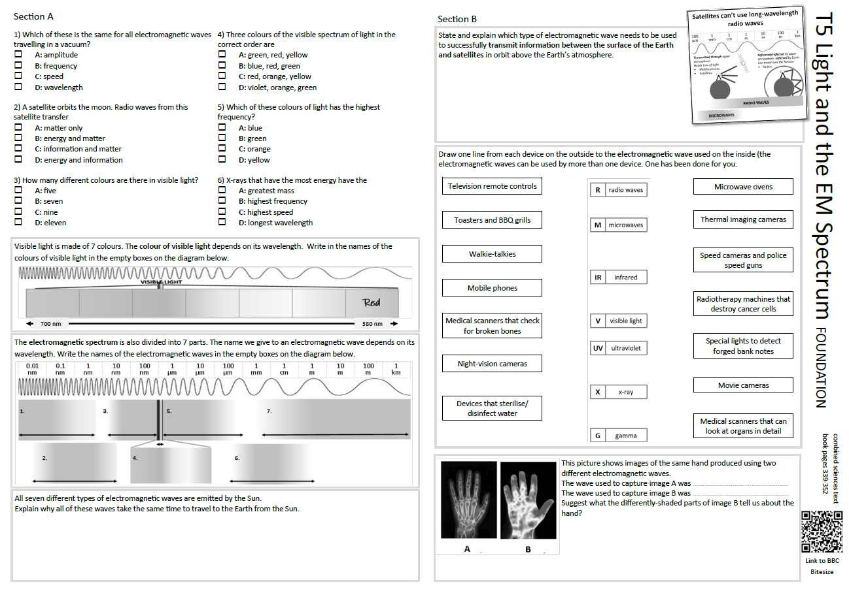
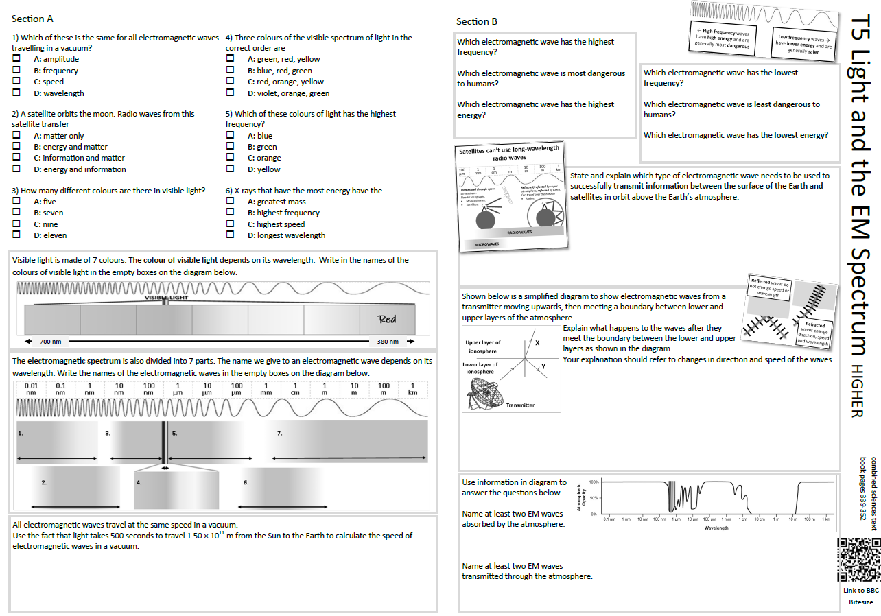
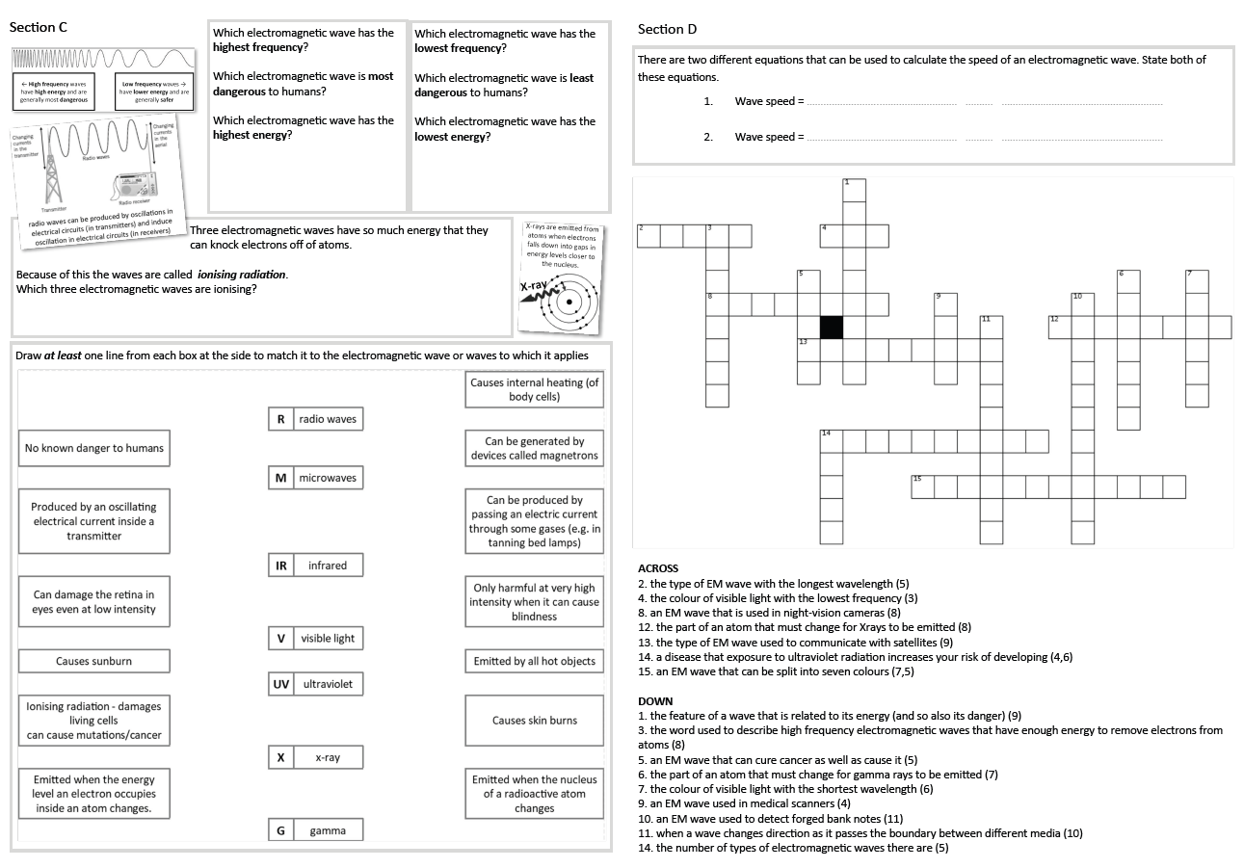
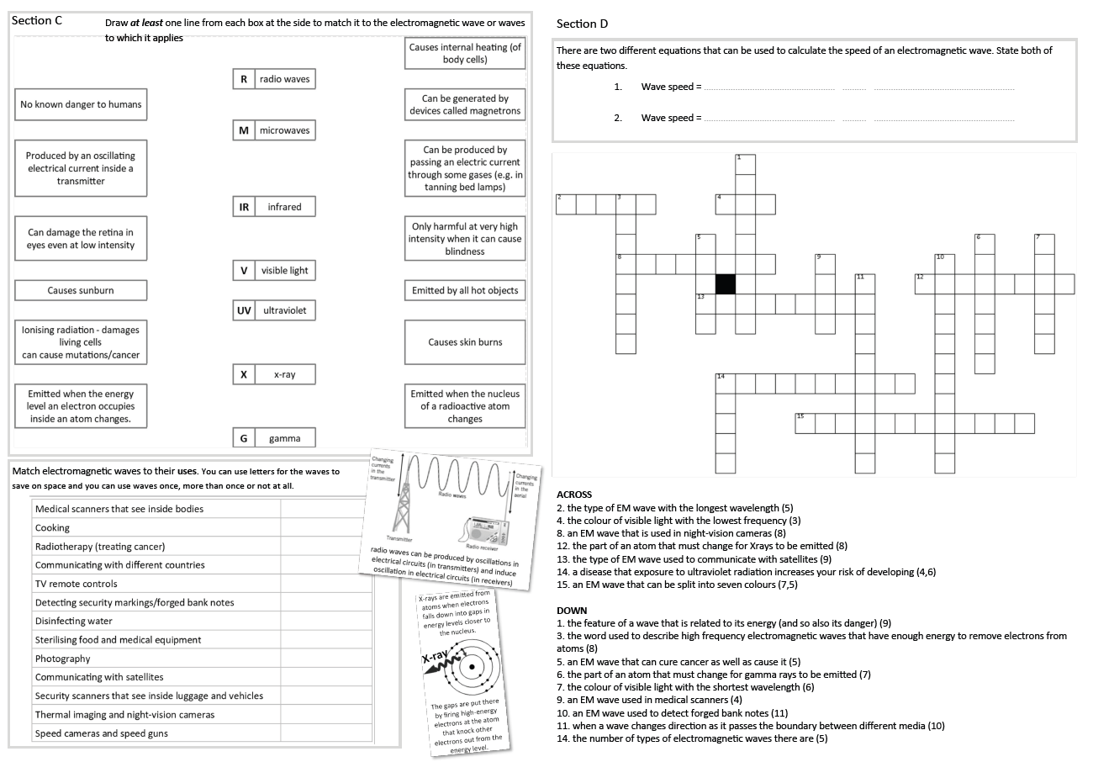
GCSE Physics Revision
Review Topic 5
Light and the Electromagnetic Spectrum
Learning Outcomes
Identify core knowledge gaps within the topic.
Practise using equations related to the topic.
Collect an A3 revision mat (←foundation or higher→)
Both sets of answers are found on these slides.
And fill in as much of section A and section B as you can.

Slide 2
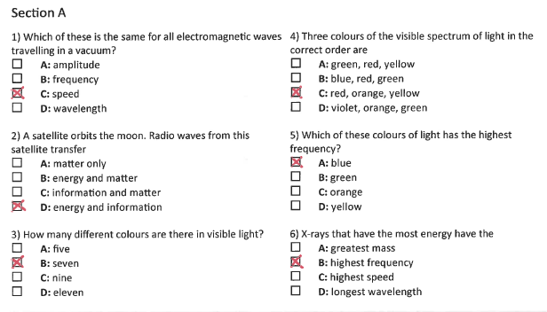
Section A
Collect an A3 revision mat (foundation or higher)
And fill in as much of section A and section B as you can.
Section B
A typical calculation from this topic
Section C
Section D
Extension task: Past paper
Click again to show answers to section A multiple choice
Click again to show answers to section bottom half

Slide 3

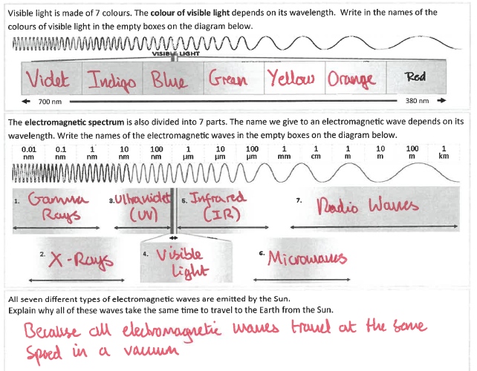
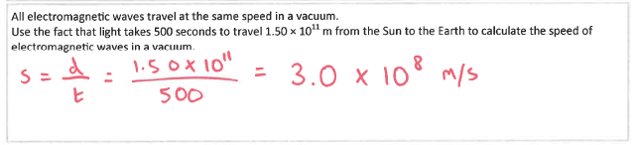
Section A
Fill in as much of section A and section B as you can.
Section B
A typical calculation from this topic
Section C
Section D
Foundation
Extension task: Past paper
Higher
Click again to show answers to section B top half

Slide 4
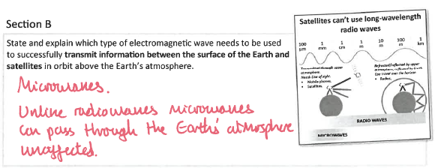
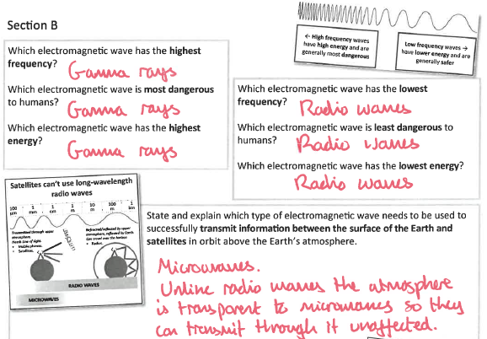
Section A
Fill in as much of section A and section B as you can.
Section B
Foundation
A typical calculation from this topic
Section C
Higher
Section D
Extension task: Past paper
Click again to show answers to section B bottom half

Slide 5
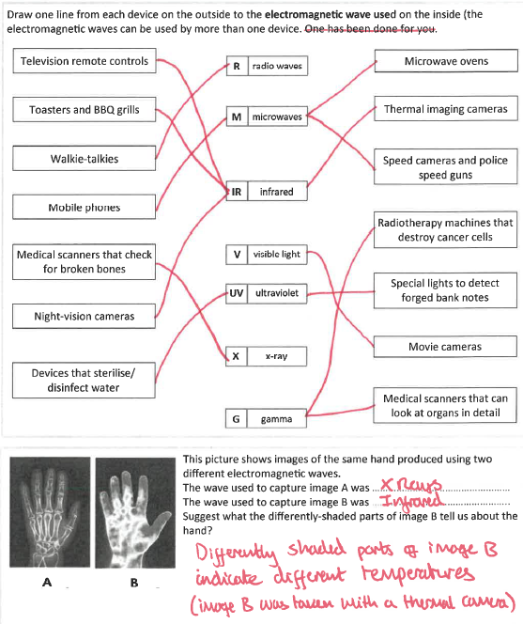
Section A
Section B
Foundation
A typical calculation from this topic
Section C
Section D
Extension task: Past paper
Click again to show higher section B

Slide 6
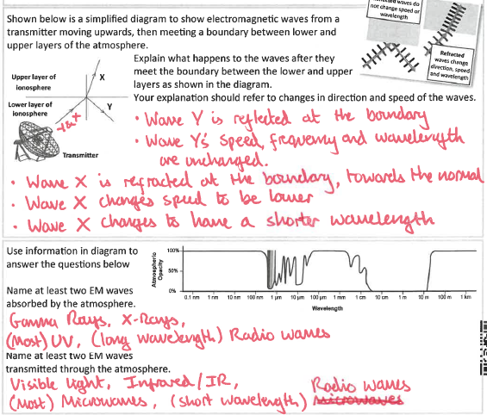
Section A
Higher
Section B
A typical calculation from this topic
Section C
Section D
Extension task: Past paper
Click again to show equations to model answering

Slide 7
Section A
Section B
A robot on the moon sends information back to the Earth at a speed of 3.0 × 10⁸ m/s. Calculate the wavelength of the wave if it had a frequency of 437 MHz.
(3 marks)
use v = f × λ
A typical calculation from this topic
Section C
Section D
Extension task: Past paper
wavelength ……………………… m
Click again to show model answer

Slide 8
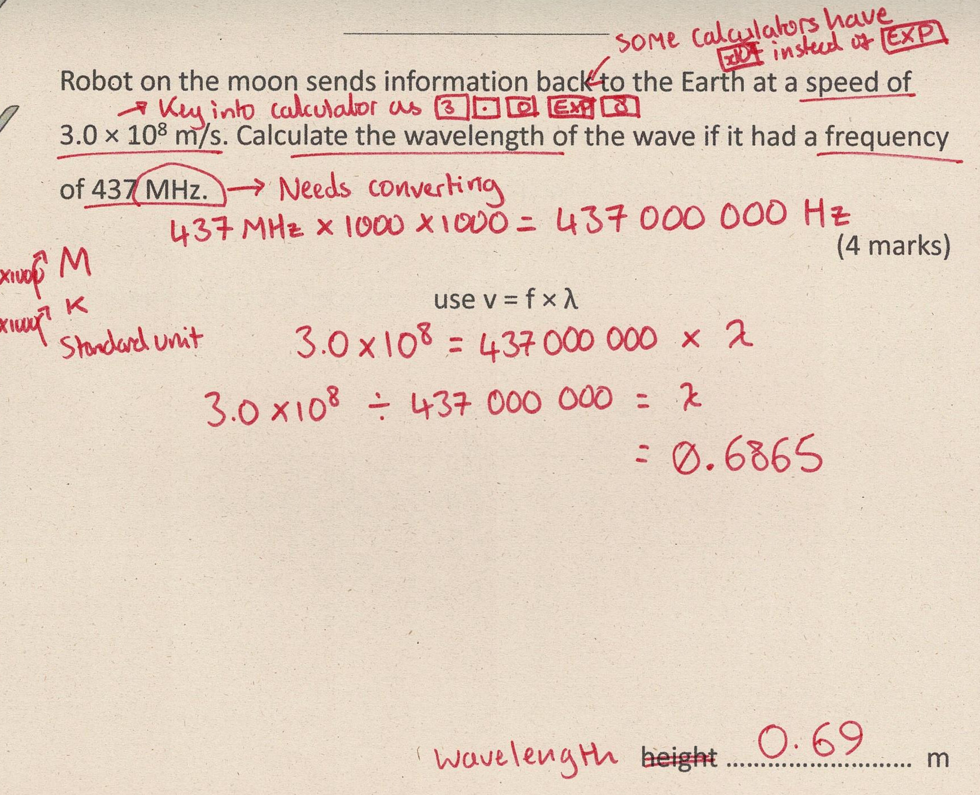
Section A
Fill in as much of section C and section D as you can.
Section B
A typical calculation from this topic
Section C
Section D
Extension task: Past paper
Click again to show answers to section C top half

Slide 9
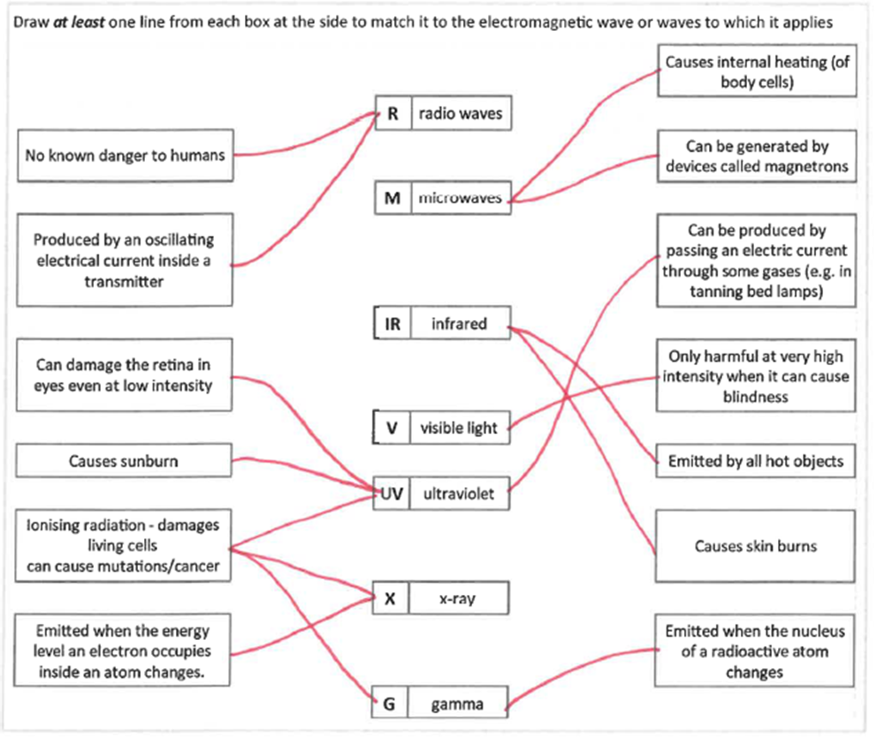
Section A
Fill in as much of section C and section D as you can.
Section B
Foundation and
Higher
A typical calculation from this topic
Section C
Section D
Extension task: Past paper
Click again to show answers to section C top half

Slide 10
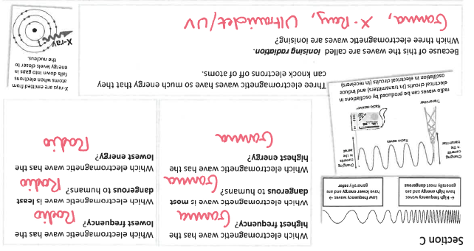
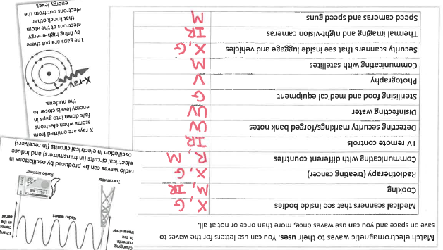
Section A
Fill in as much of section C and section D as you can.
Section B
A typical calculation from this topic
Foundation
Section C
Section D
Higher
Extension task: Past paper
Click again for top of section D

Slide 11
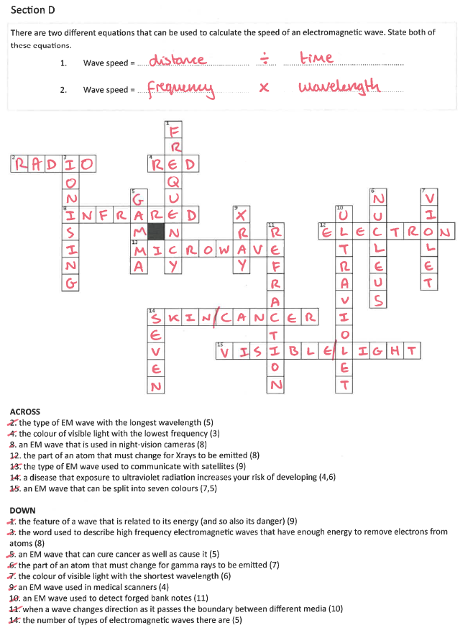
Section A
Section B
A typical calculation from this topic
Foundation and higher
Section C
Section D
Extension task: Past paper

