Slide 1
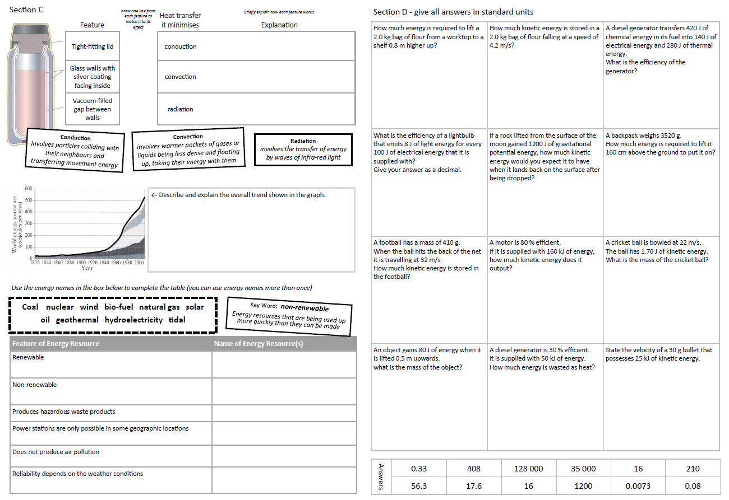
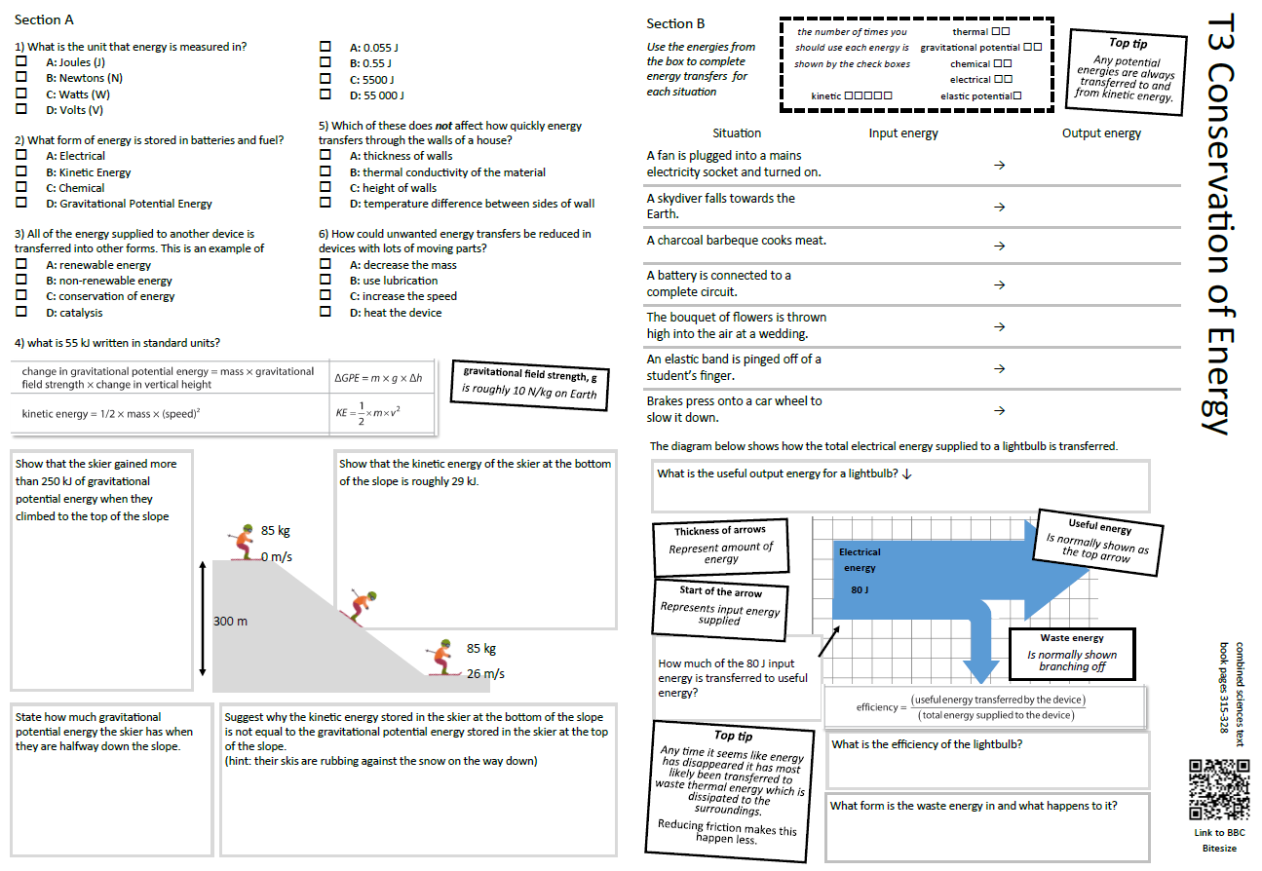
GCSE Physics Revision
Review Topic 3
Conservation of Energy
Learning Outcomes
Identify core knowledge gaps within the topic.
Practise using equations related to the topic.
Collect an A3 revision mat
(← mixed tiers - no difference for foundation or higher)
And fill in as much of section A and section B as you can.

Slide 2
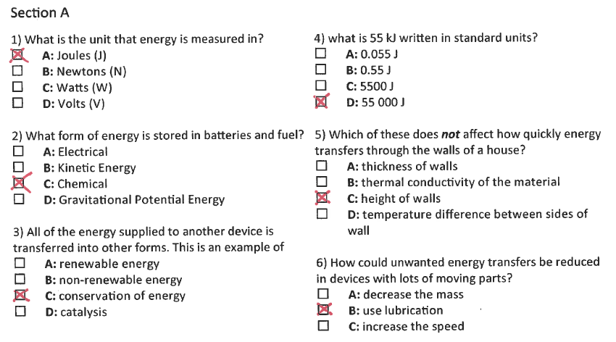
Section A
Collect an A3 revision mat (mixed tiers - higher and foundation pick up the same one)
And fill in as much of section A and section B as you can.
Section B
Thermal energy transfer recap
Section C
Section D
Extension task: Past paper
Click again to show answers to section A multiple choice
Click again to show answers to section bottom half

Slide 3

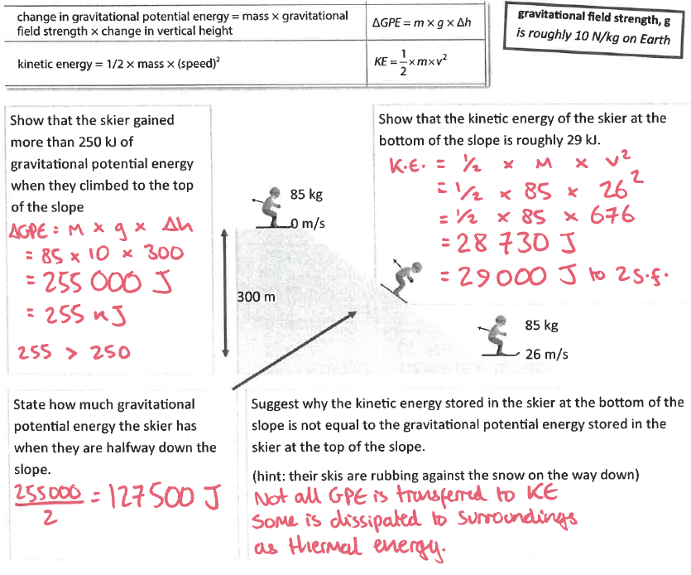
Section A
Fill in as much of section A and section B as you can.
Section B
Thermal energy transfer recap
Section C
Section D
Extension task: Past paper
Click again to show exermplar to section B top half

Slide 4
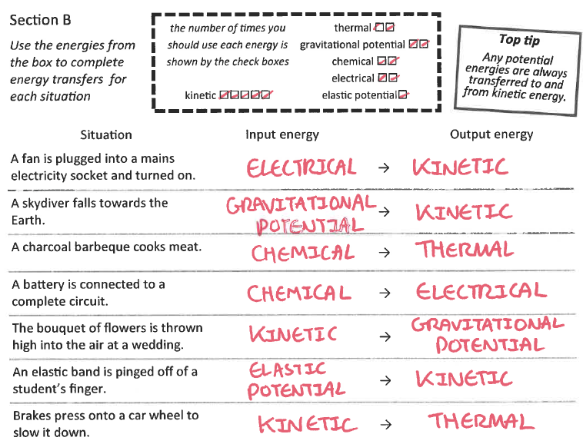
Section A
Fill in as much of section A and section B as you can.
Section B
Is something changing speed?
Yes
No
Thermal energy transfer recap
Speeding up (gaining kinetic energy)
Kinetic energy is not involved
…………. → Kinetic energy
If it seems like energy disappeared it probably shifted to a store of thermal energy in the surroundings.
Section C
Slowing down (losing kinetic energy)
Section D
Kinetic energy → ………….
Extension task: Past paper
1
2
Click again to show answers to example energy shifts on this screen
Click again to show answers to section B bottom half

Slide 5
Section A
Fill in as much of section A and section B as you can.
Section B
Thermal energy transfer recap
Section C
Section D
Extension task: Past paper
Click again to show answers to section B bottom half

Slide 6
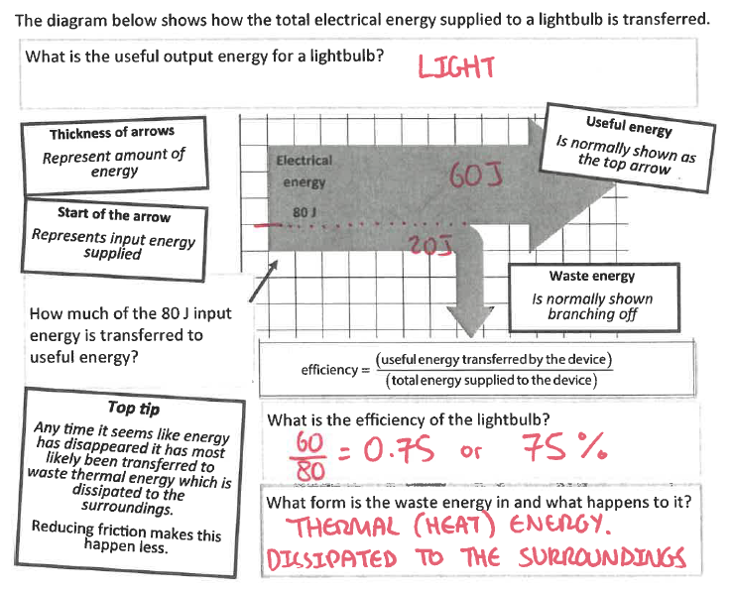
Section A
Section B
Thermal energy transfer recap
Section C
Section D
Extension task: Past paper
Click again to show equations to model answering

Slide 7
11D only got up to Here

Slide 8
Section A
Section B
A rock 5 kg rock falls from the top of a cliff and has 0.5 kJ of kinetic energy just before it hits to sea. Assuming that no energy was transferred to thermal or sound energy while the rock fell, how high was the cliff?
gravitational field strength = 10 N/kg
(3 marks)
use ΔGPE = m × g × Δh
A typical calculation from this topic
Section C
Section D
Extension task: Past paper
height ……………………… m
Click again to show model answer

Slide 9
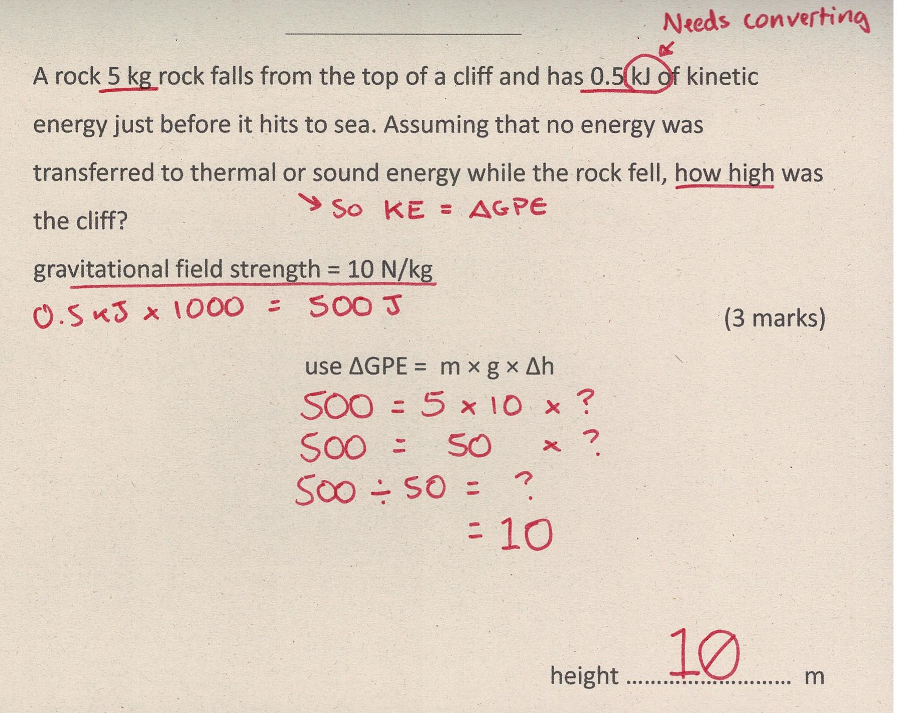
Section A
Fill in as much of section C and section D as you can.
Section B
A typical calculation from this topic
Section C
Section D
Extension task: Past paper
Click again to show answers to section C top half

Slide 10
Section A
Fill in as much of section C and section D as you can.
Section B
Thermal energy transfer recap
Section C
Section D
Extension task: Past paper
Click again to show model answer

Slide 11
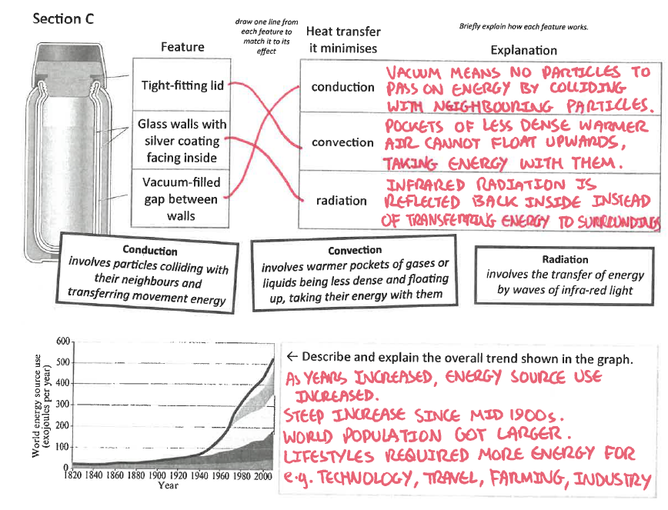
Section A
Fill in as much of section C and section D as you can.
Section B
A typical calculation from this topic
Section C
Section D
Extension task: Past paper
Click again to show answers to section C bottom half

Slide 12
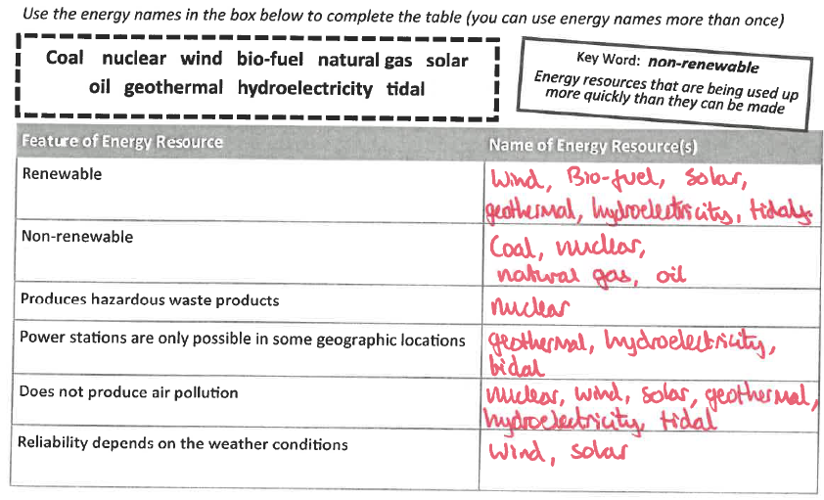
Section A
Fill in as much of section C and section D as you can.
Section B
A typical calculation from this topic
Section C
Section D
Extension task: Past paper
Click again for top of section D

Slide 13
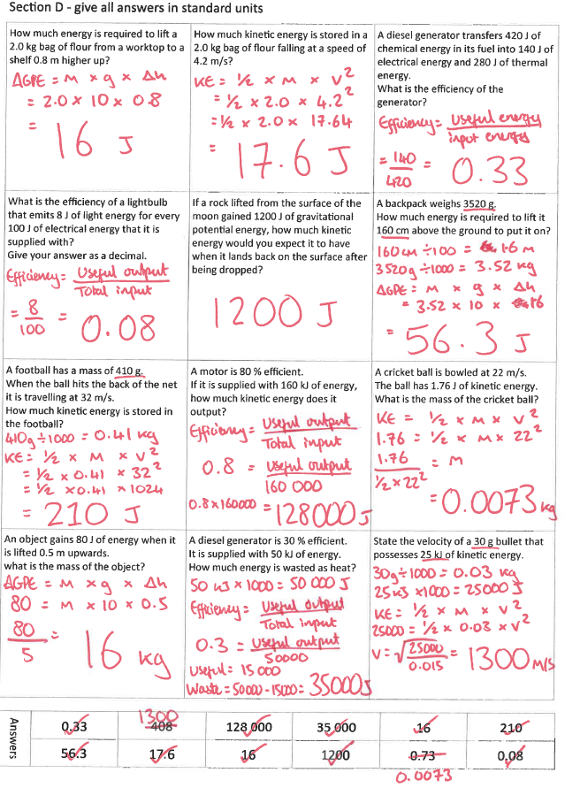
Section A
Section B
A typical calculation from this topic
Section C
Section D
Extension task: Past paper
END

