Slide 1
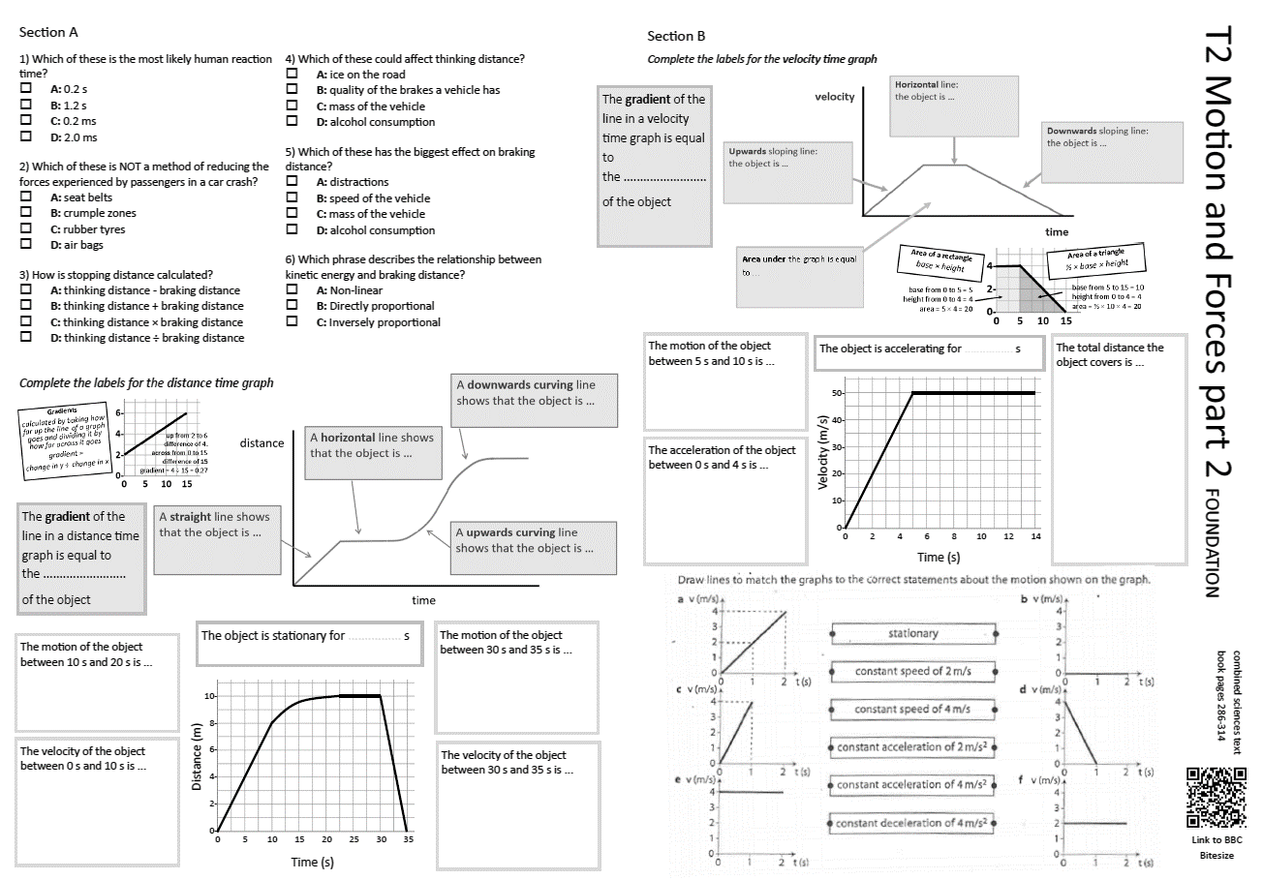
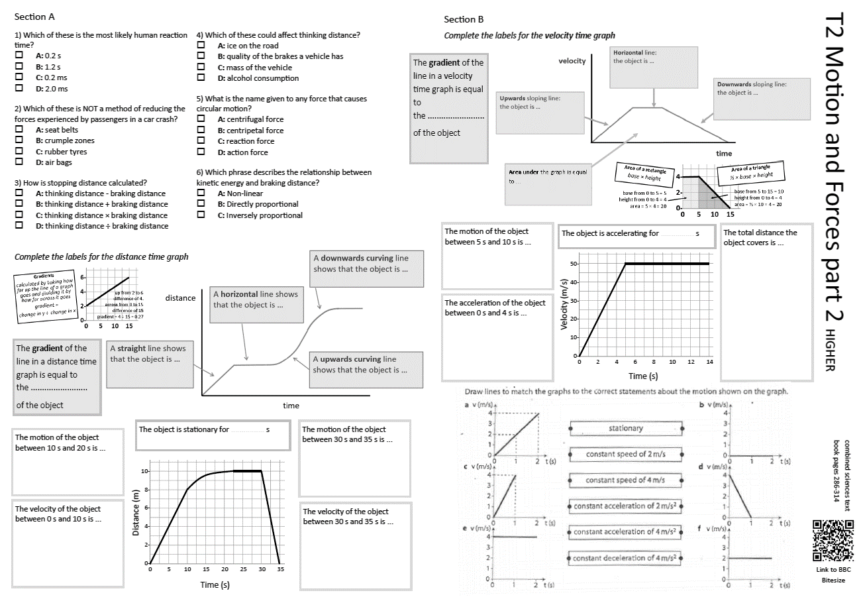
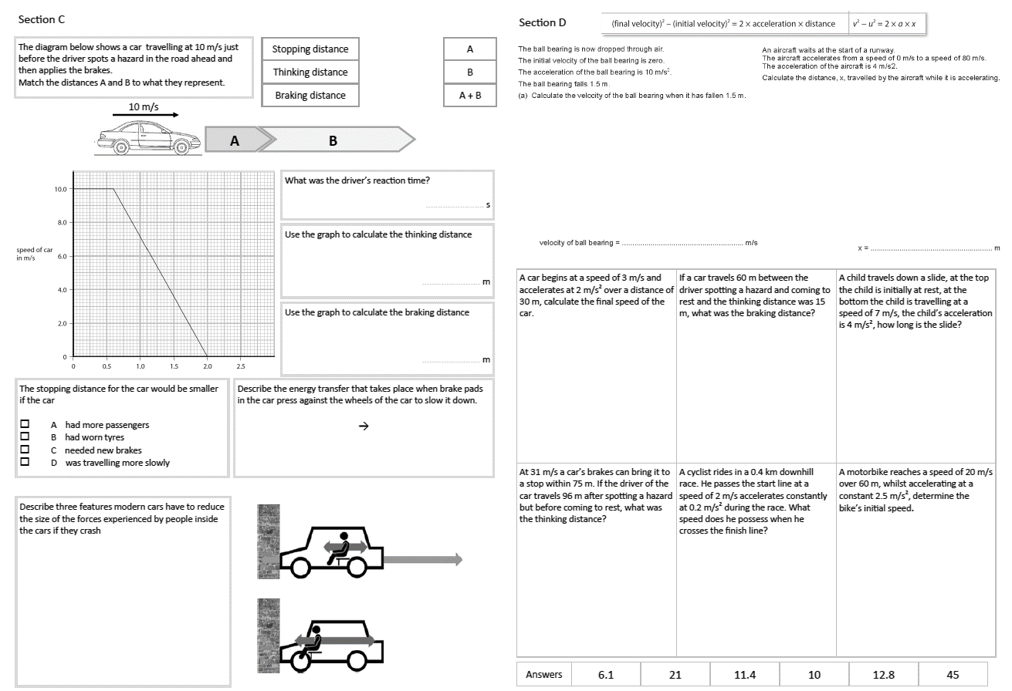
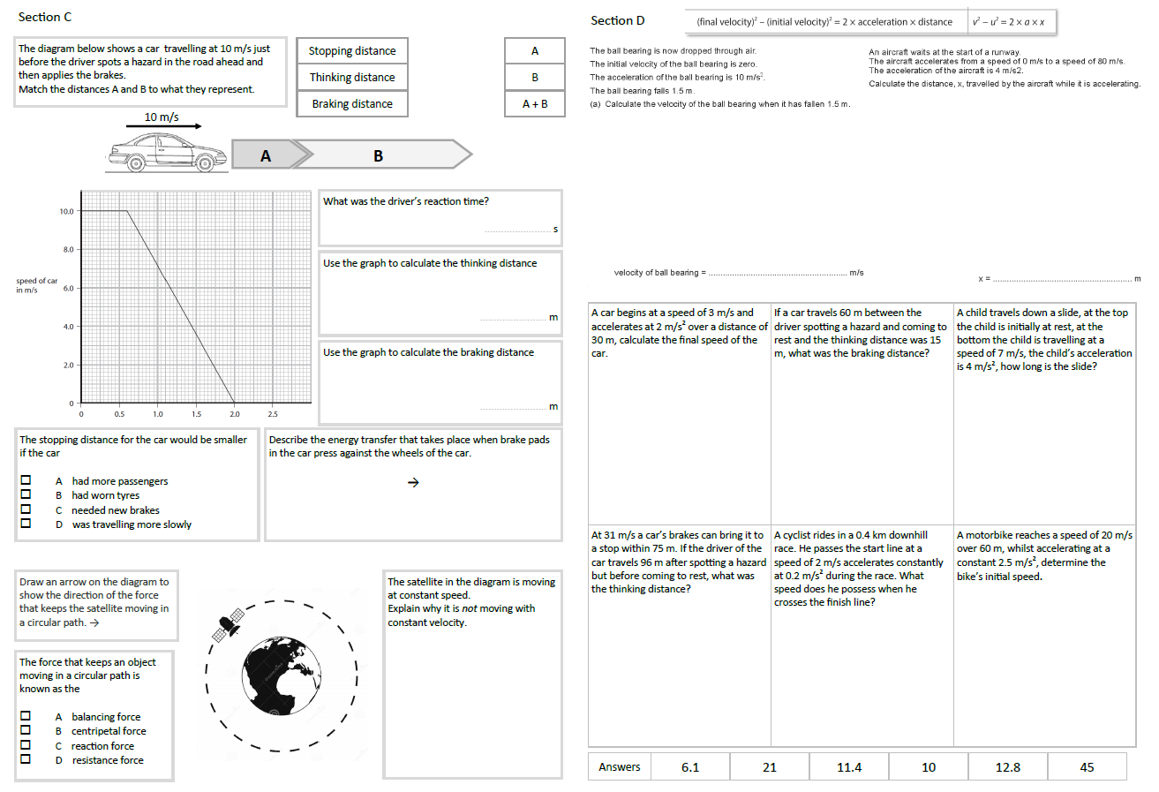
GCSE Physics Revision
Review Topic 2 part 2
Motion and Forces
Learning Outcomes
Identify core knowledge gaps within the topic.
Practise using equations related to the topic.
Collect an A3 revision mat (←foundation or higher→)
Both sets of answers are found on these slides.
And fill in as much of section A and section B as you can.

Slide 2
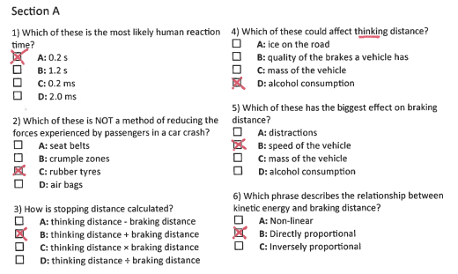
Section A
Collect an A3 revision mat (higher or foundation)
And fill in as much of section A and section B as you can.
Section B
A typical calculation from this topic
Section C
Section D
Extension task: Past paper
Click again to show answers to section A multiple choice
Click again to show answers to section bottom half

Slide 3

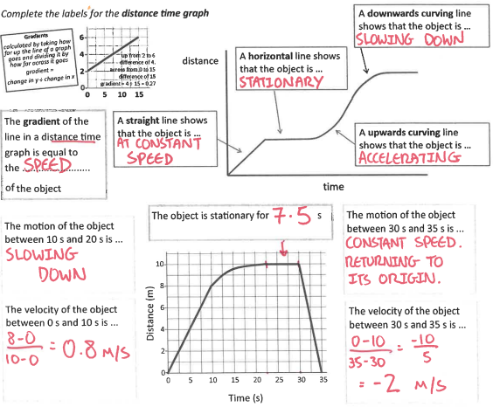
Section A
Fill in as much of section A and section B as you can.
Section B
A typical calculation from this topic
Section C
Section D
Extension task: Past paper
Click again to show answers to section B top half

Slide 4
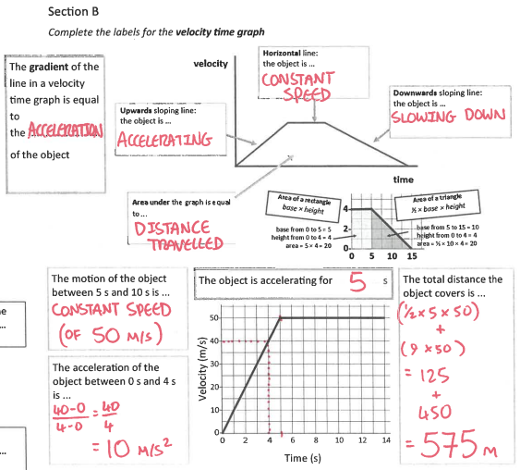
Section A
Fill in as much of section A and section B as you can.
Section B
A typical calculation from this topic
Section C
Section D
Extension task: Past paper
Click again to show answers to section B bottom half

Slide 5
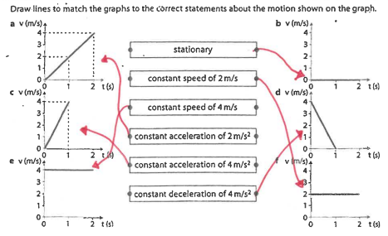
Section A
Section B
A typical calculation from this topic
Section C
Section D
Extension task: Past paper
Click again to show equations to model answering

Slide 6
Section A
Section B
A tennis ball is dropped from the roof of a school. It falls 20 m to the ground. What speed does it hit the ground with? Assume air resistance is negligible. (3 marks)
use v² – u² = 2 × a × x
A typical calculation from this topic
Section C
Speed ……………………… m/s
Section D
A football is travelling at 30 m/s when it leaves a player’s foot. Air resistance and friction slows the ball down at an average rate of -6 m/s ². How far will the ball have travelled before it’s velocity is reduced to 1.4 m/s? (3 marks)
Extension task: Past paper
distance ……………………… m
Click again to show model answers

Slide 7
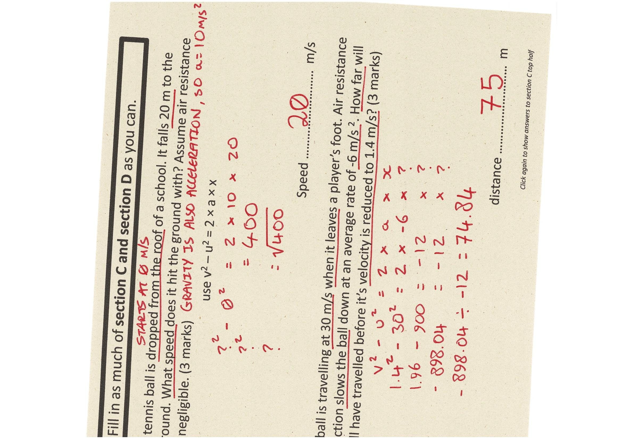
Section A
Fill in as much of section C and section D as you can.
Section B
A tennis ball is dropped from the roof of a school. It falls 20 m to the ground. What speed does it hit the ground with? Assume air resistance is negligible. (3 marks)
use v² – u² = 2 × a × x
A typical calculation from this topic
Section C
Speed ……………………… m/s
Section D
A football is travelling at 30 m/s when it leaves a player’s foot. Air resistance and friction slows the ball down at an average rate of -6 m/s ². How far will the ball have travelled before it’s velocity is reduced to 1.4 m/s? (3 marks)
Extension task: Past paper
distance ……………………… m
Click again to show answers to section C top half

Slide 8
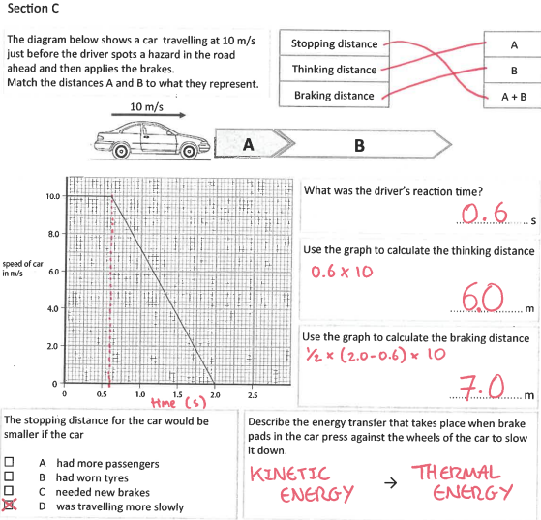
Section A
Fill in as much of section C and section D as you can.
Section B
A typical calculation from this topic
Section C
Section D
Extension task: Past paper
Click again to show answers to section C bottom half

Slide 9
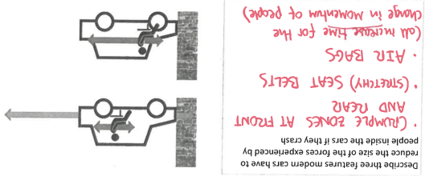
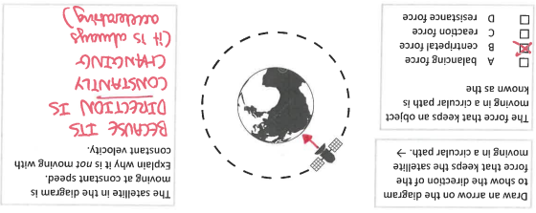
Section A
Fill in as much of section C and section D as you can.
Section B
Foundation
A typical calculation from this topic
Section C
Section D
Higher
Extension task: Past paper
Click again for top of section D

Slide 10
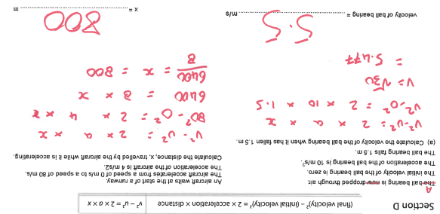
Section A
Fill in as much of section C and section D as you can.
Section B
A typical calculation from this topic
Section C
Section D
Extension task: Past paper
END

