Slide 1
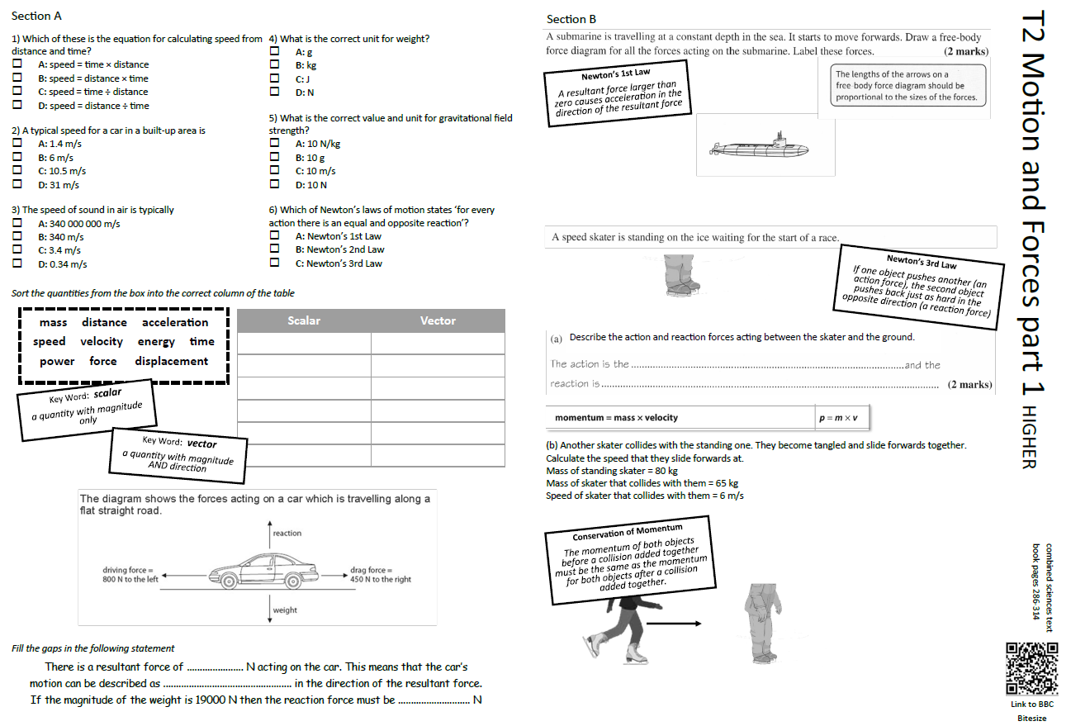
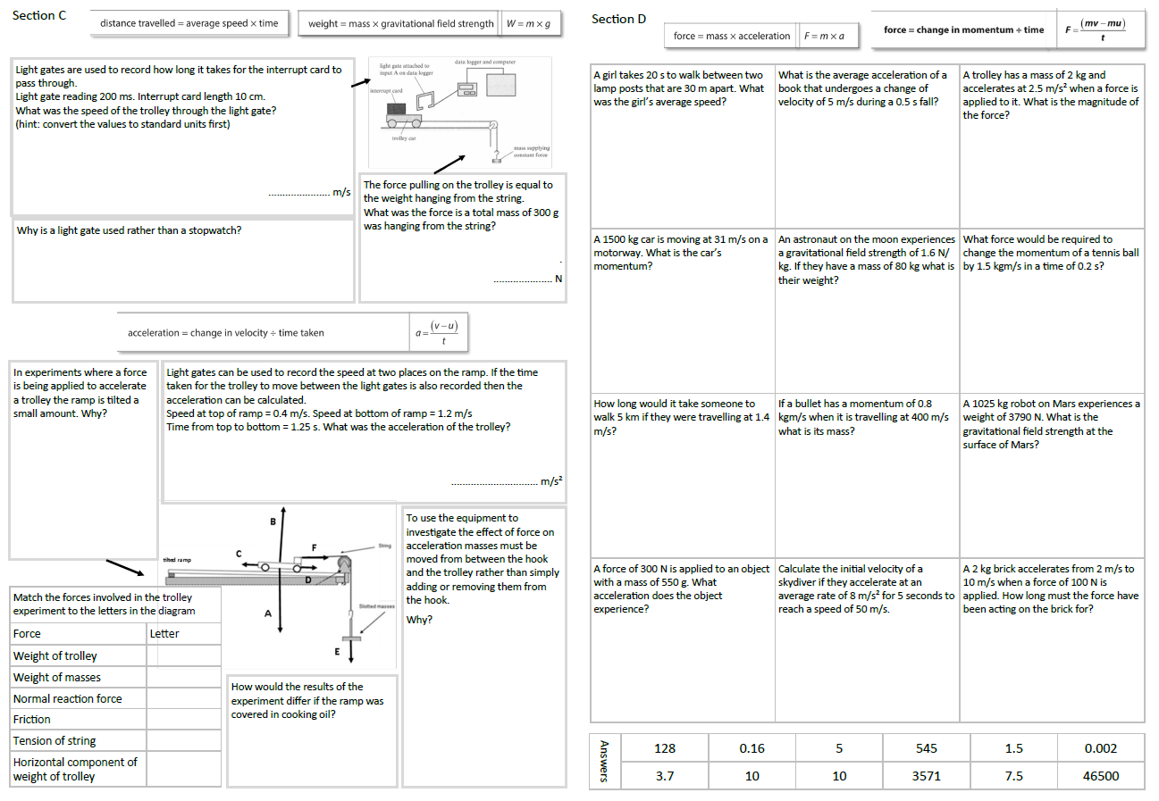
GCSE Physics Revision
Review Topic 2 part 1
Motion and Forces
Learning Outcomes
Identify core knowledge gaps within the topic.
Practise using equations related to the topic.
Collect an A3 revision mat
(←higher worksheet only - answers to the foundation tier worksheet are on a different set of slides)
And fill in as much of section A and section B as you can.

Slide 2
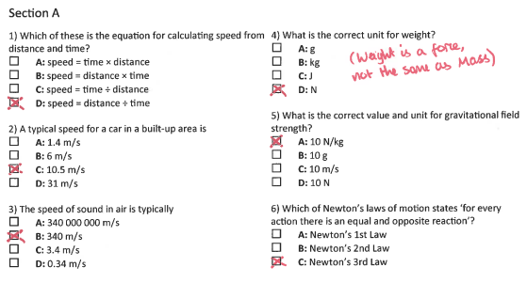
Section A
Collect an A3 revision mat (higher only)
And fill in as much of section A and section B as you can.
Section B
A typical calculation from this topic
Section C
Section D
Extension task: Past paper
Click again to show answers to section A multiple choice
Click again to show answers to section bottom half

Slide 3

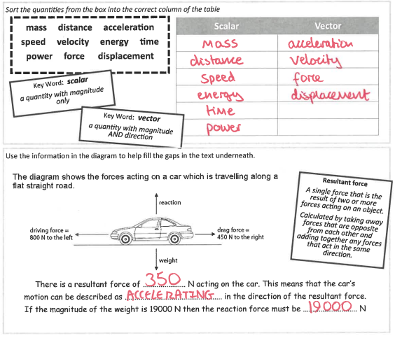
Section A
Fill in as much of section A and section B as you can.
Section B
A typical calculation from this topic
Section C
Section D
Extension task: Past paper
Click again to show answers to section B top half

Slide 4
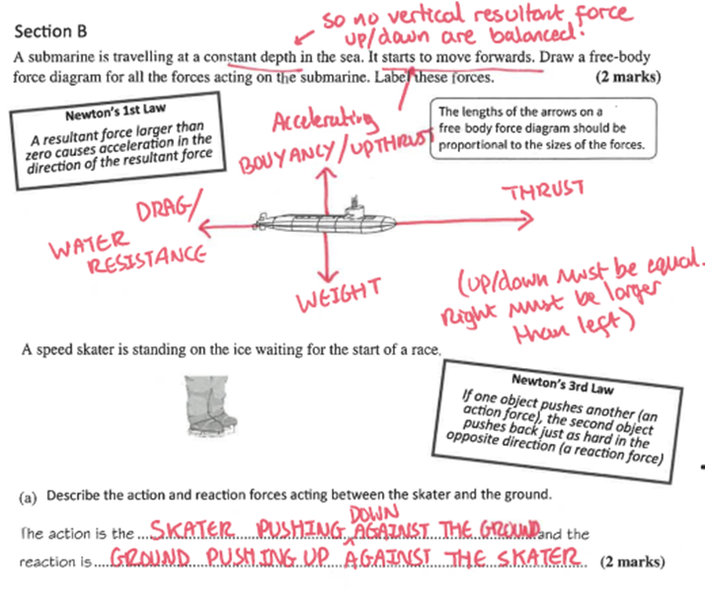
Section A
Fill in as much of section A and section B as you can.
Section B
A typical calculation from this topic
Section C
Section D
Extension task: Past paper
Click again to show answers to section B bottom half

Slide 5
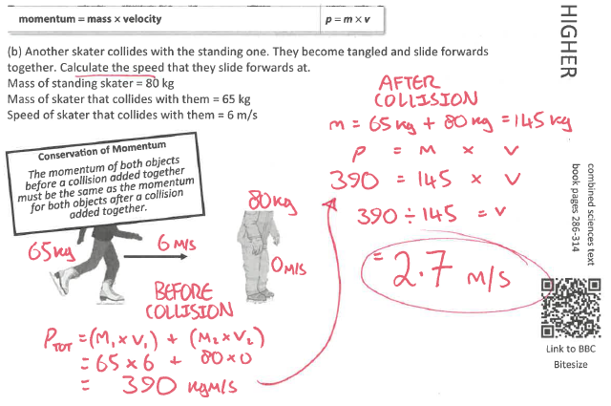
Section A
Section B
A typical calculation from this topic
Section C
Section D
Extension task: Past paper
Click again to show equations to model answering

Slide 6
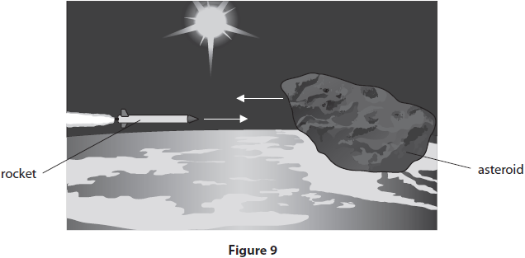
Section A
Fill in as much of section C and section D as you can.
Section B
Figure 9 is a diagram showing a rocket that is sent into space to try and change the path of a small asteroid.
The rocket has a mass of 5 × 10⁵ kg and its momentum is 7 × 10⁹ kgm/s.
The asteroid has a momentum of 7.5 × 10¹⁰ kgm/s and a mass of 8.0 × 10⁶ kg.
The rocket is designed to combine with the asteroid upon collision. What is the velocity of the asteroid after the collision?
A typical calculation from this topic
Section C
Section D
Extension task: Past paper
Click again to show model answer

Slide 7
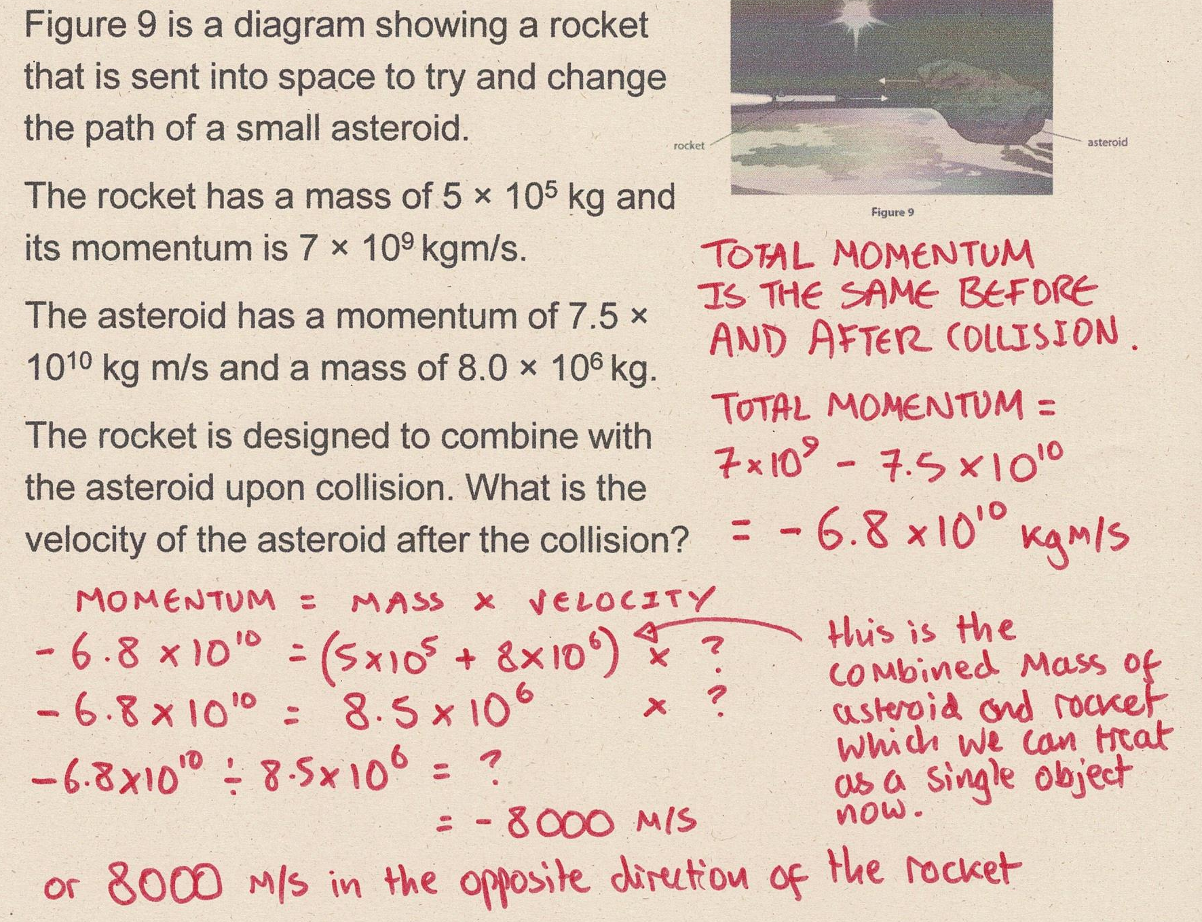
Section A
Fill in as much of section C and section D as you can.
Section B
A typical calculation from this topic
Section C
Section D
Extension task: Past paper
Click again to show answers to section C top half

Slide 8
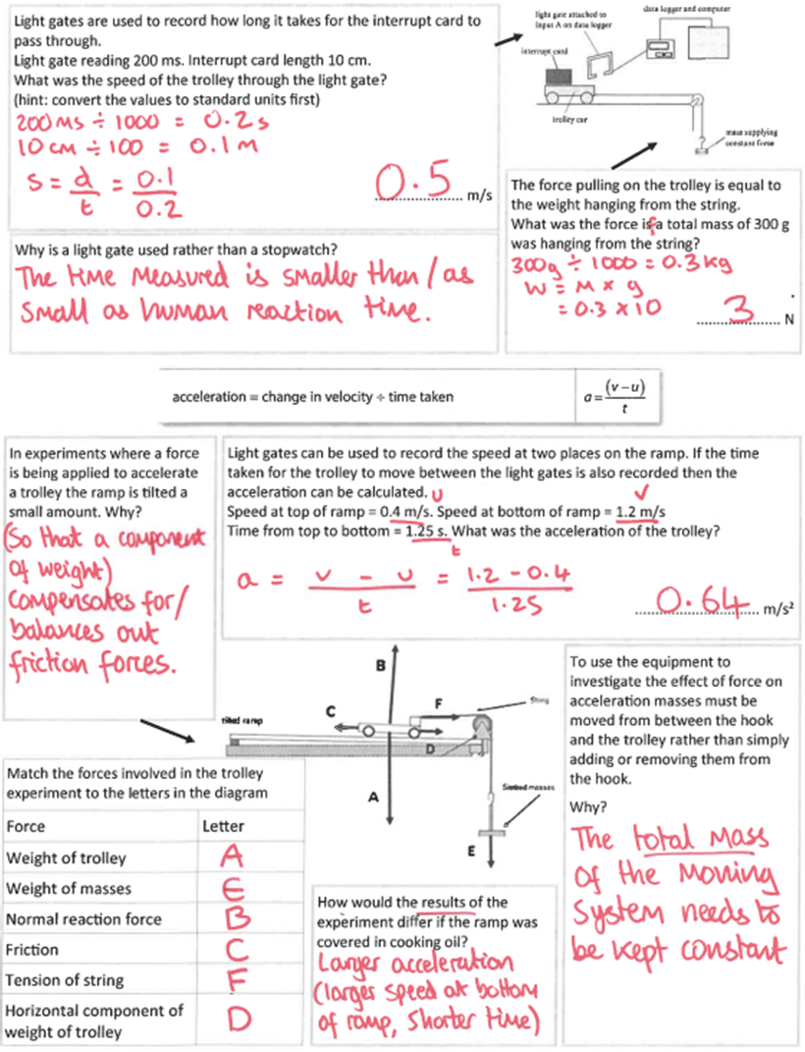
Section A
Fill in as much of section C and section D as you can.
Section B
A typical calculation from this topic
Section C
Section D
Extension task: Past paper
Click again to show answers to section C bottom half

Slide 9
Section A
Fill in as much of section C and section D as you can.
Section B
A typical calculation from this topic
Section C
Section D
Extension task: Past paper
Click again for top of section D

Slide 10
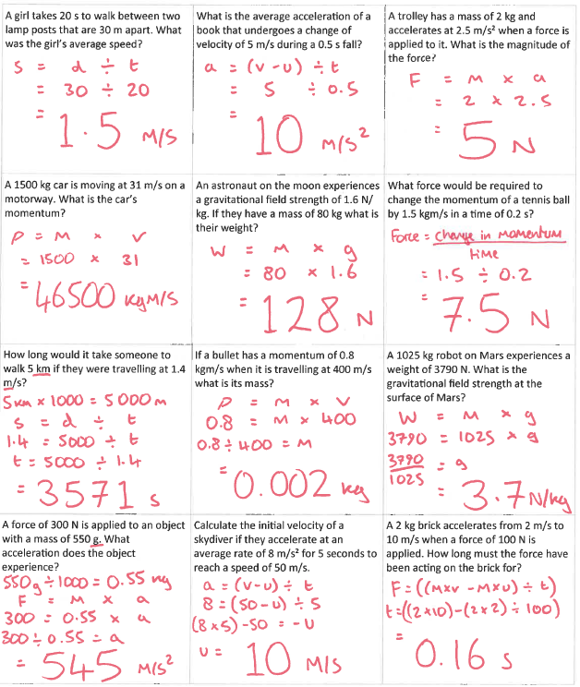
Section A
Section B
A typical calculation from this topic
Section C
Section D
Extension task: Past paper
END

