Slide 1
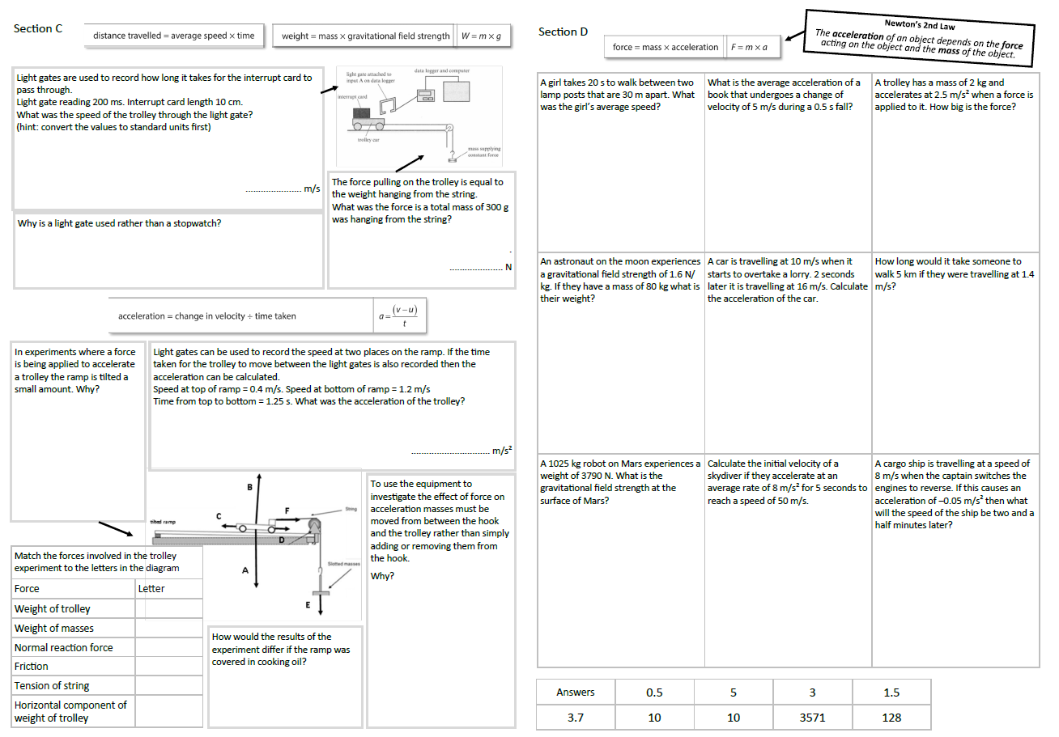
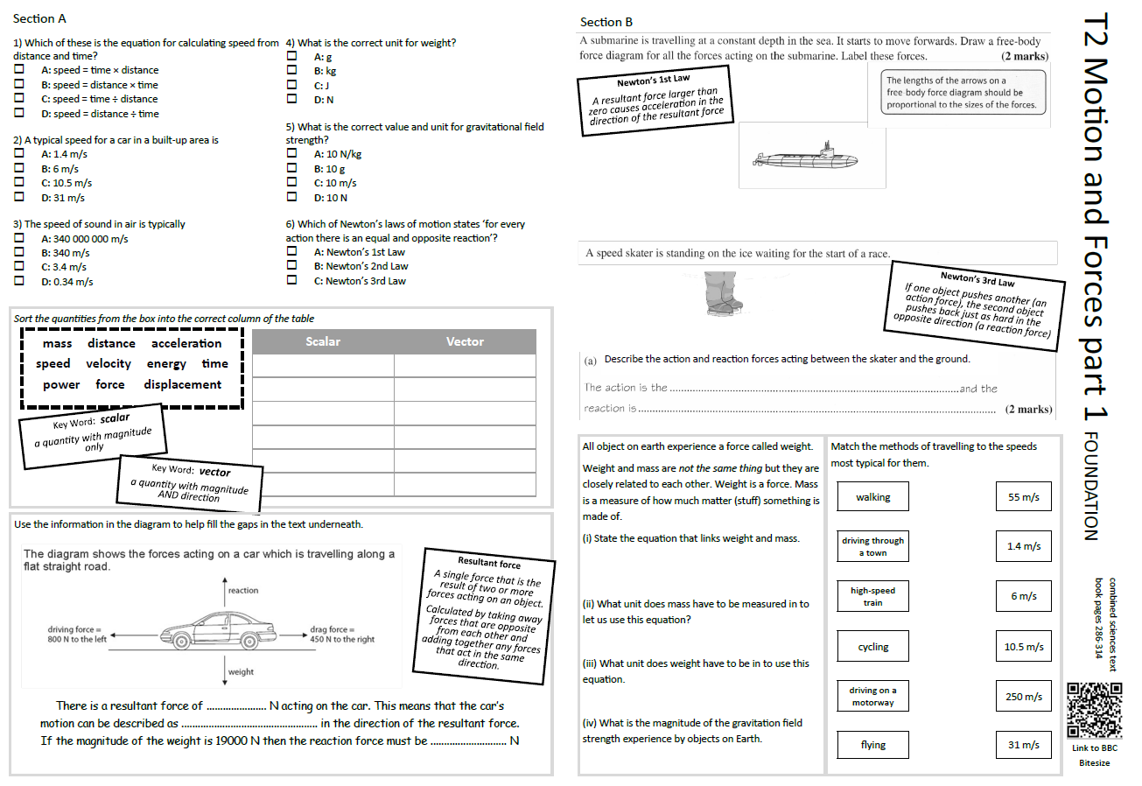
GCSE Physics Revision
Review Topic 2 part 1
Motion and Forces
Learning Outcomes
Identify core knowledge gaps within the topic.
Practise using equations related to the topic.
Collect an A3 revision mat
(← foundation worksheet only - answers to the higher tier worksheet are on a different set of slides)
And fill in as much of section A and section B as you can.

Slide 2
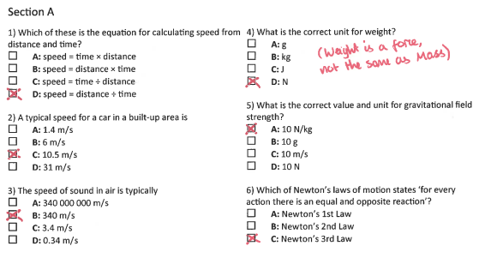
Section A
Collect an A3 revision mat (foundation only)
And fill in as much of section A and section B as you can.
Section B
A typical calculation from this topic
Section C
Section D
Extension task: Past paper
Click again to show answers to section A multiple choice
Click again to show answers to section bottom half

Slide 3

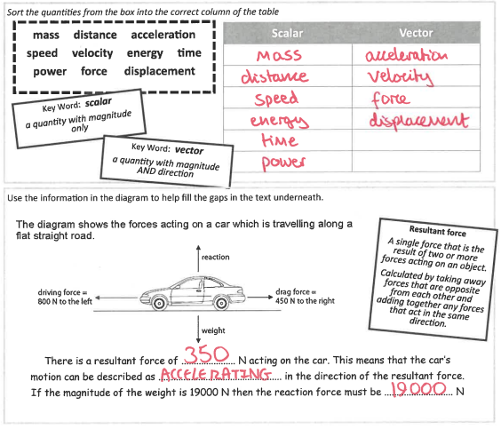
Section A
Fill in as much of section A and section B as you can.
Section B
A typical calculation from this topic
Section C
Section D
Extension task: Past paper
Click again to show answers to section B top half

Slide 4
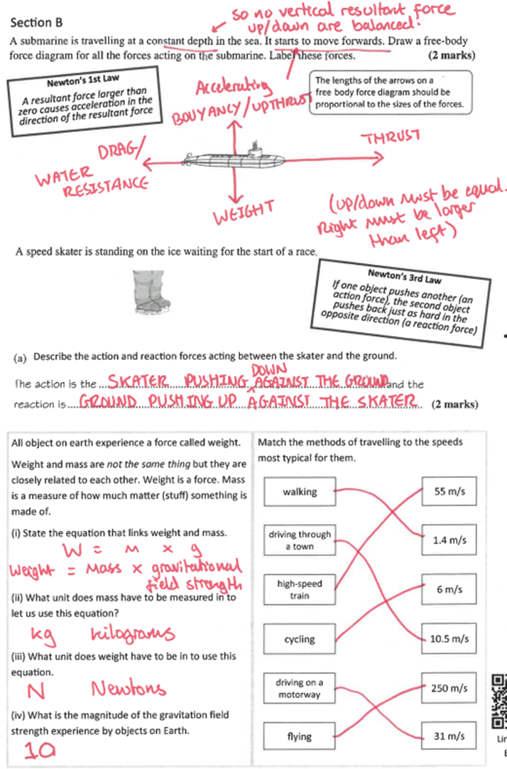
Section A
Fill in as much of section A and section B as you can.
Section B
A typical calculation from this topic
Section C
Section D
Extension task: Past paper
Click again to show answers to section B bottom half

Slide 5
Section A
Section B
A typical calculation from this topic
Section C
Section D
Extension task: Past paper
Click again to show equations to model answering

Slide 6
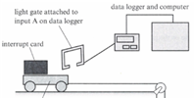
Section A
Section B
A data logger records a time of 90 ms when a trolley passes under it.
The width of the card that went through the light gate was 8 cm.
(i) Find the speed of the trolley. (3 marks)
A typical calculation from this topic
Section C
Section D
Speed ……………………… m/s
(ii) 2.0 seconds after passing through the light gate the trolley is moving at 1.2 m/s. What was the average acceleration of the trolley?
Use a = (v - u) ÷ t
(2 marks)
Extension task: Past paper
acceleration ……………………… unit ………..
Click again to show worked answers

Slide 7
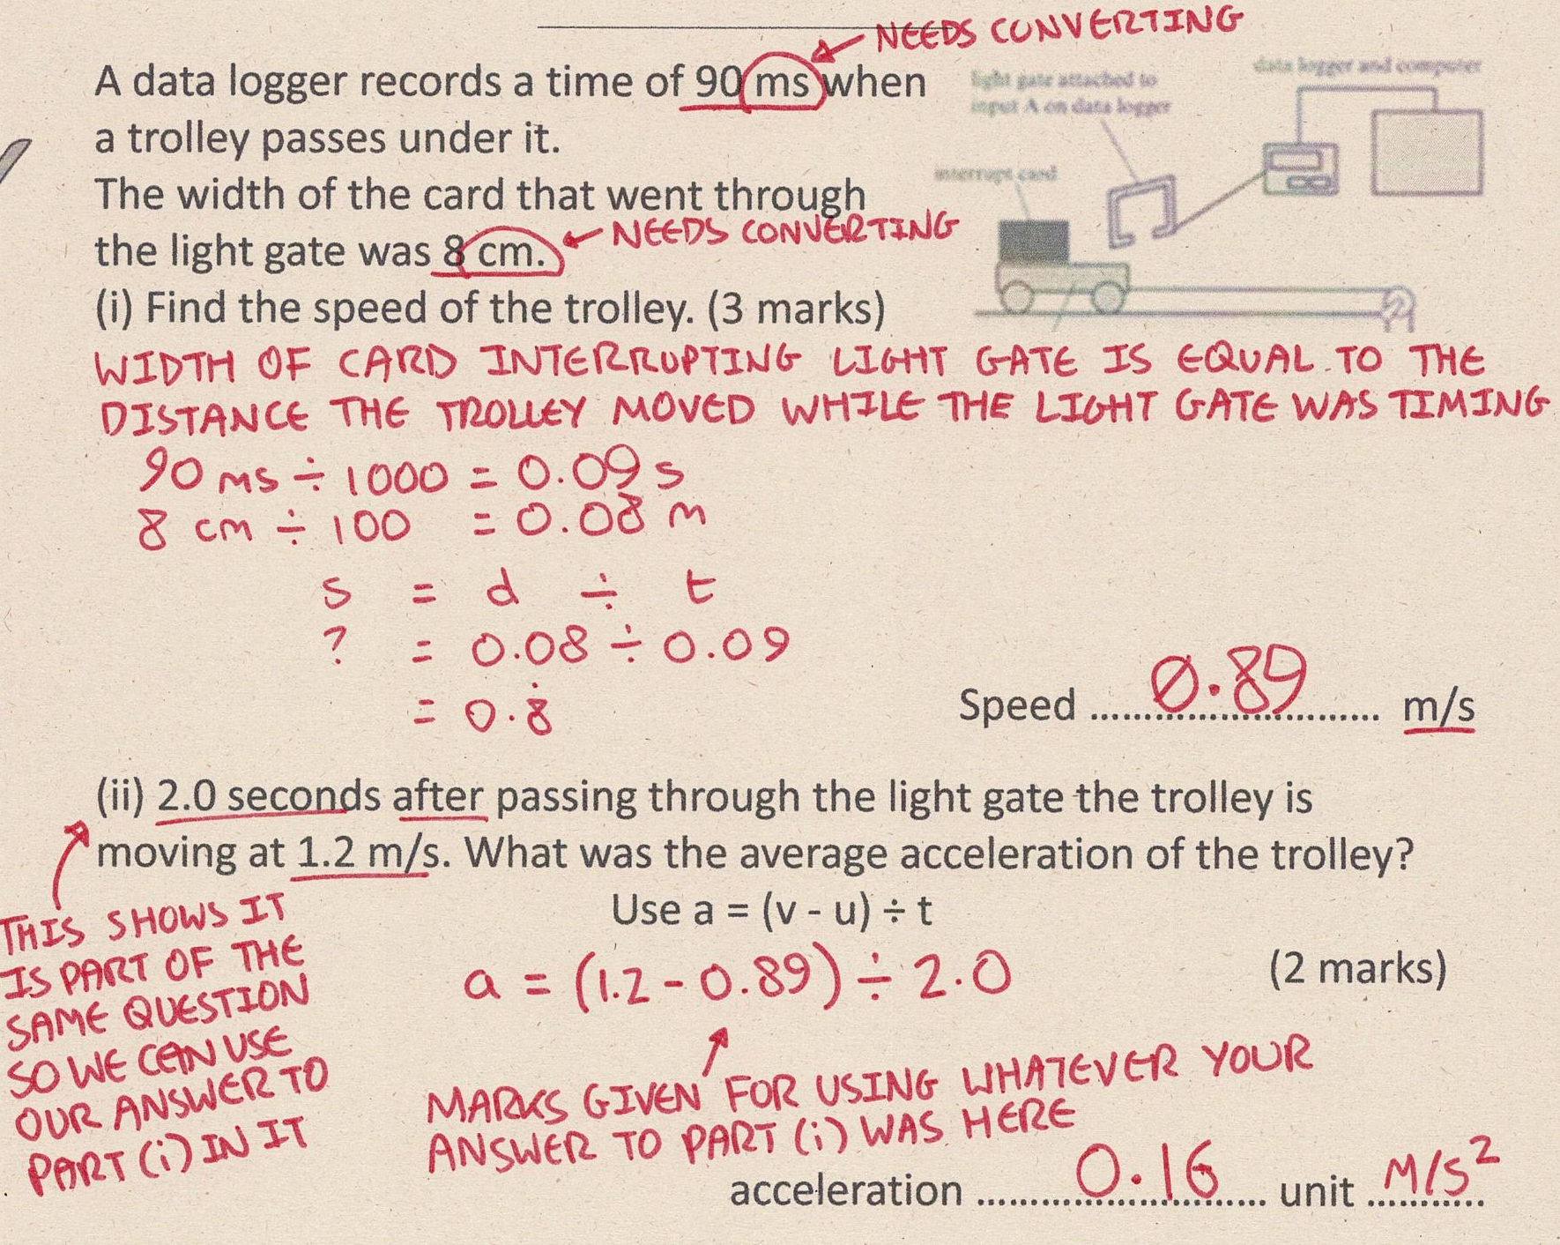
Section A
Fill in as much of section C and section D as you can.
Section B
A typical calculation from this topic
Section C
Section D
Extension task: Past paper
Click again to show answers to section C top half

Slide 8
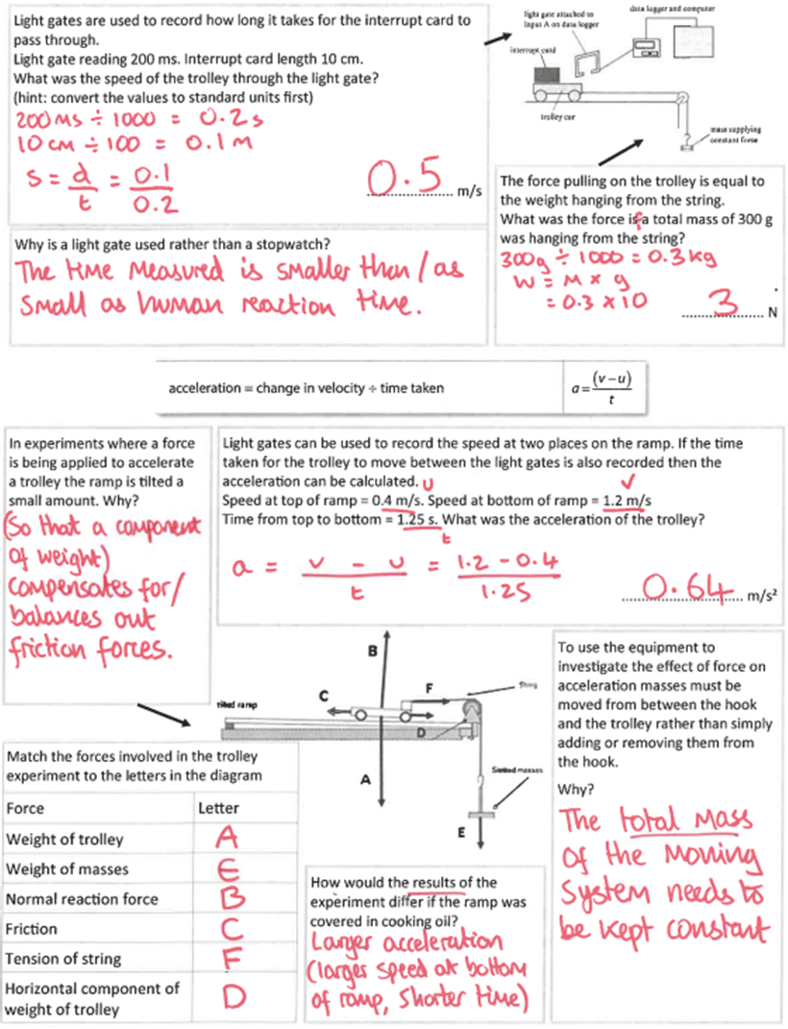
Section A
Fill in as much of section C and section D as you can.
Section B
A typical calculation from this topic
Section C
Section D
Extension task: Past paper
Click again to show answers to section C bottom half

Slide 9
Section A
Fill in as much of section C and section D as you can.
Section B
A typical calculation from this topic
Section C
Section D
Extension task: Past paper
Click again for top of section D

Slide 10
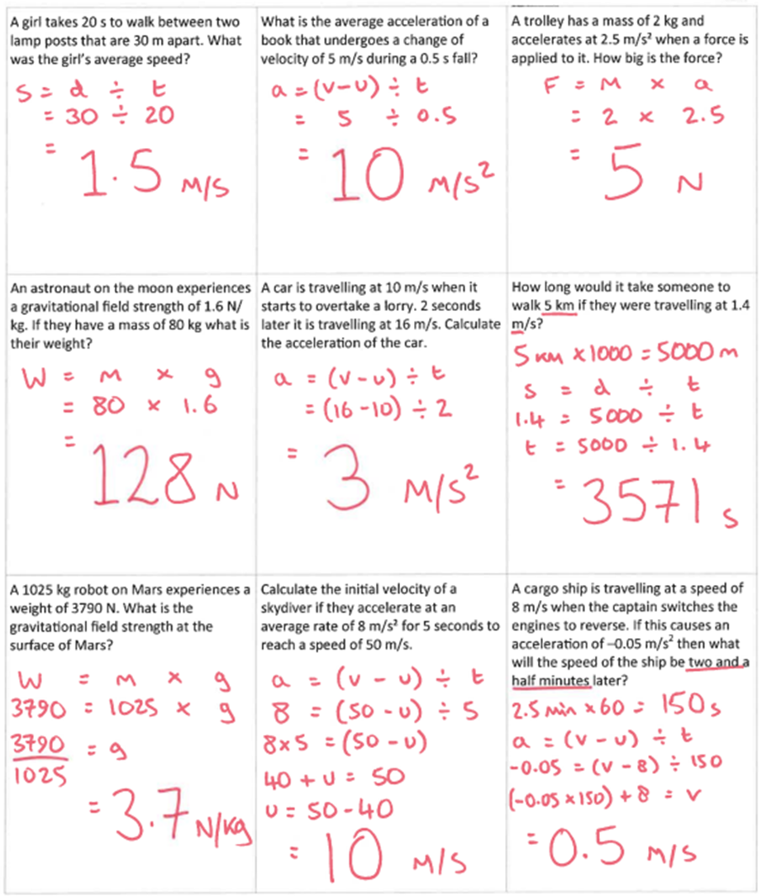
Section A
Fill in as much of section C and section D as you can.
Section B
A typical calculation from this topic
Section C
Section D
Extension task: Past paper
END

