Slide 1
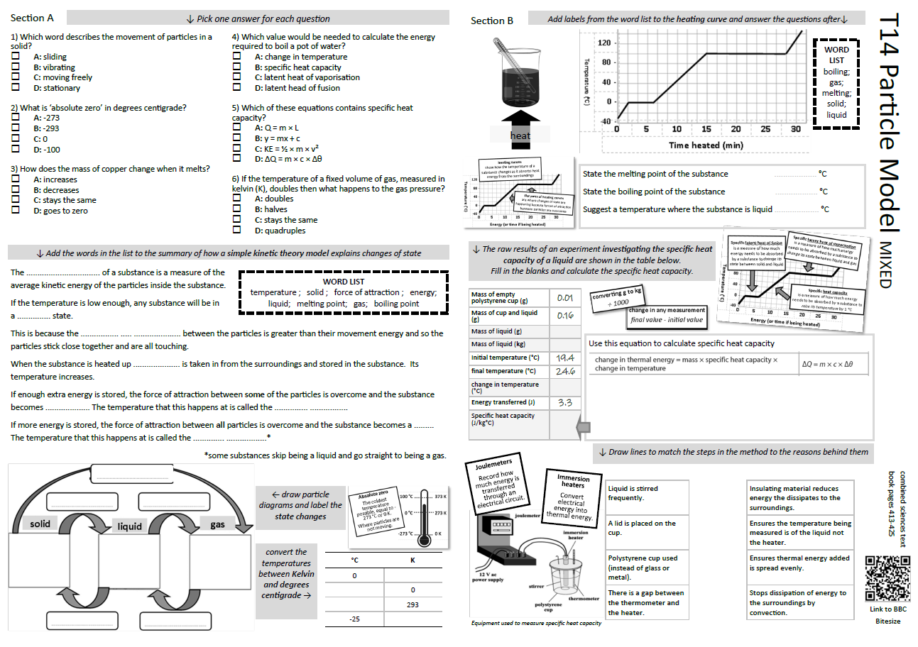
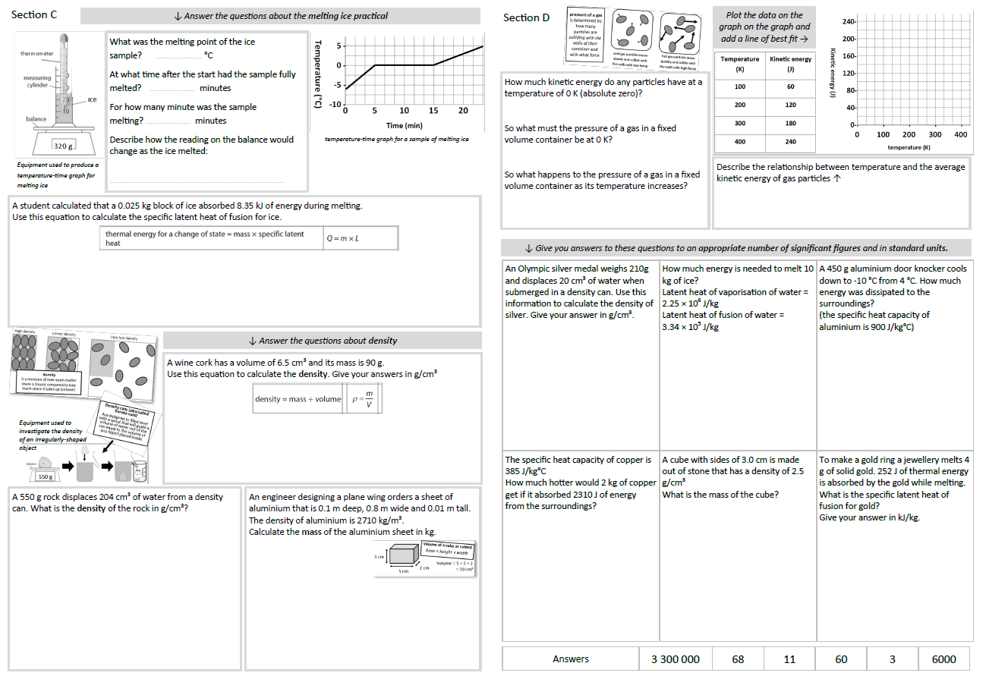
GCSE Physics Revision
Review Topic 14
Particle Model
Learning Outcomes
Identify core knowledge gaps within the topic.
Practise using equations related to the topic.
Collect an A3 revision mat
(← mixed tiers - no difference for foundation or higher)
And fill in as much of section A and section B as you can.

Slide 2
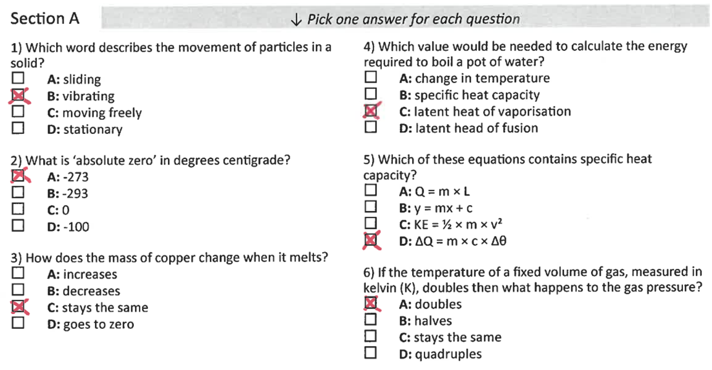
Section A
Collect an A3 revision mat (mixed tiers - higher and foundation pick up the same one)
And fill in as much of section A and section B as you can.
Section B
A typical calculation from this topic
Section C
Section D
Extension task: Past paper
Click again to show answers to section A multiple choice
Click again to show answers to section bottom half

Slide 3

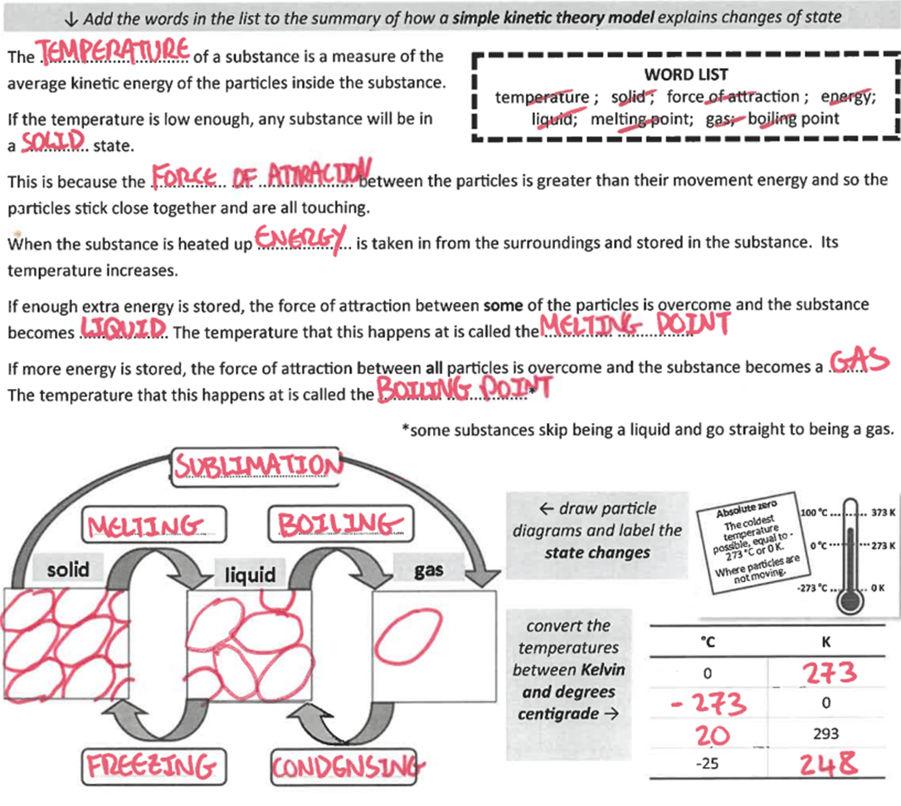
Section A
Fill in as much of section A and section B as you can.
Section B
A typical calculation from this topic
Section C
Section D
Extension task: Past paper
Click again to show answers to section B top half

Slide 4
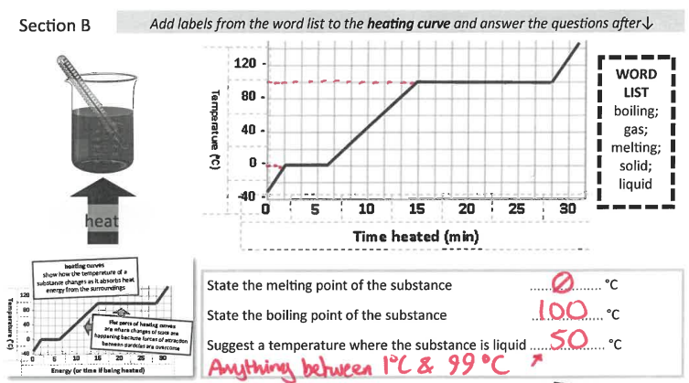
Section A
Fill in as much of section A and section B as you can.
Section B
gas
A typical calculation from this topic
boiling
liquid
melting
Section C
solid
Section D
Extension task: Past paper
Click again to show answers to section B bottom half

Slide 5
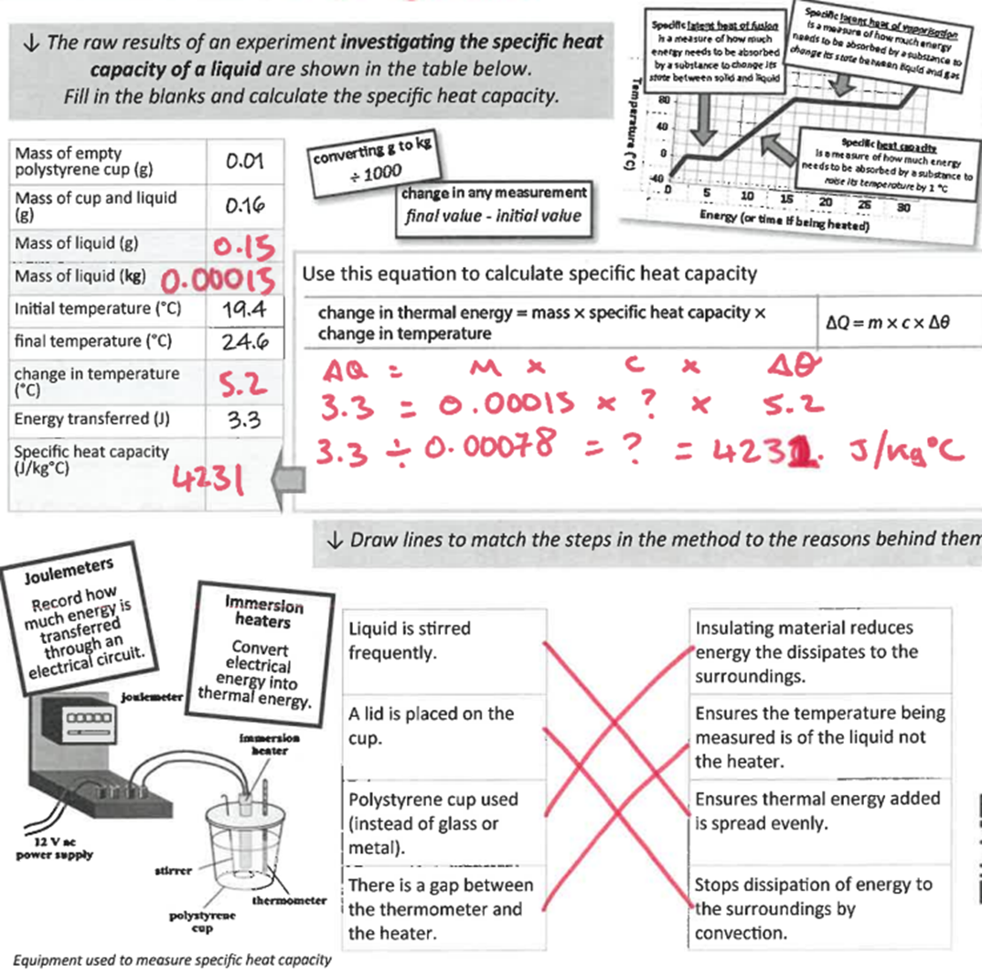
Section A
Section B
A typical calculation from this topic
Section C
Section D
Extension task: Past paper
Click again to show higher section B

Slide 6
Section A
Section B
The latent heat of vaporisation of water is 2 260 000 J/kg.
The specific heat capacity of water is 4200 J/kgºC
1 kg of water at 20 ºC is put into a saucepan and left there until it has absorbed 500 000 J of thermal energy.
How much of the water turns to steam?
(5 marks)
A typical calculation from this topic
Section C
Section D
Extension task: Past paper
mass of steam ……………………… kg
Click again to show model answer

Slide 7
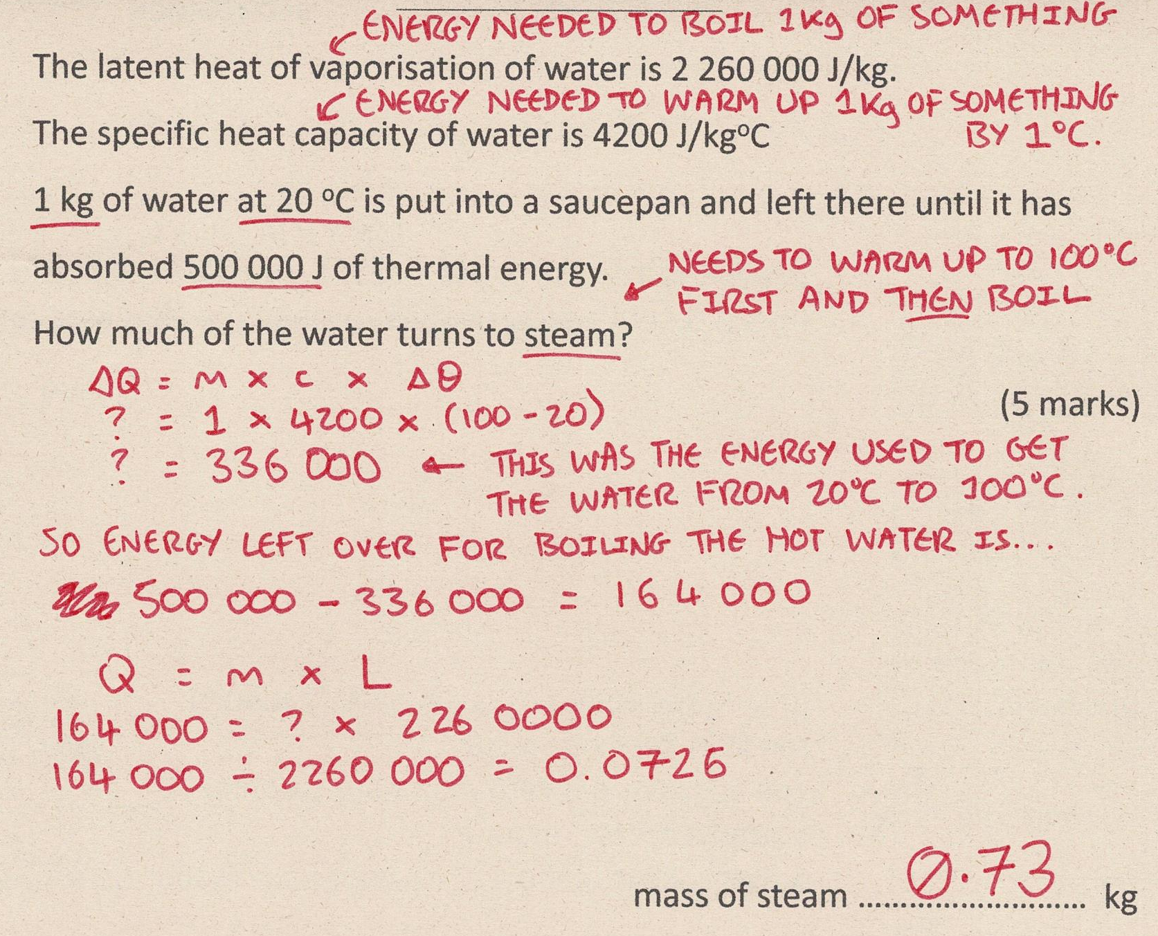
Section A
Fill in as much of section C and section D as you can.
Section B
A typical calculation from this topic
Section C
Section D
Extension task: Past paper
Click again to show answers to section C top half

Slide 8
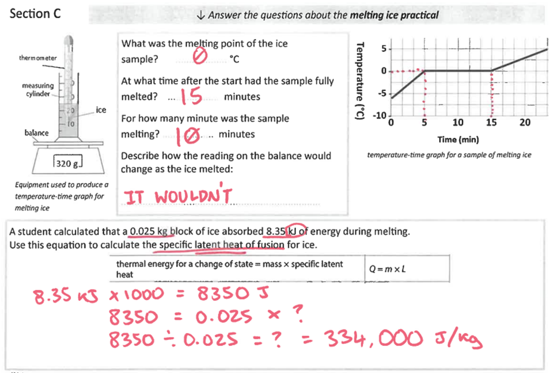
Section A
Fill in as much of section C and section D as you can.
Section B
A typical calculation from this topic
Section C
Section D
Extension task: Past paper
Click again to show answers to section C top half

Slide 9
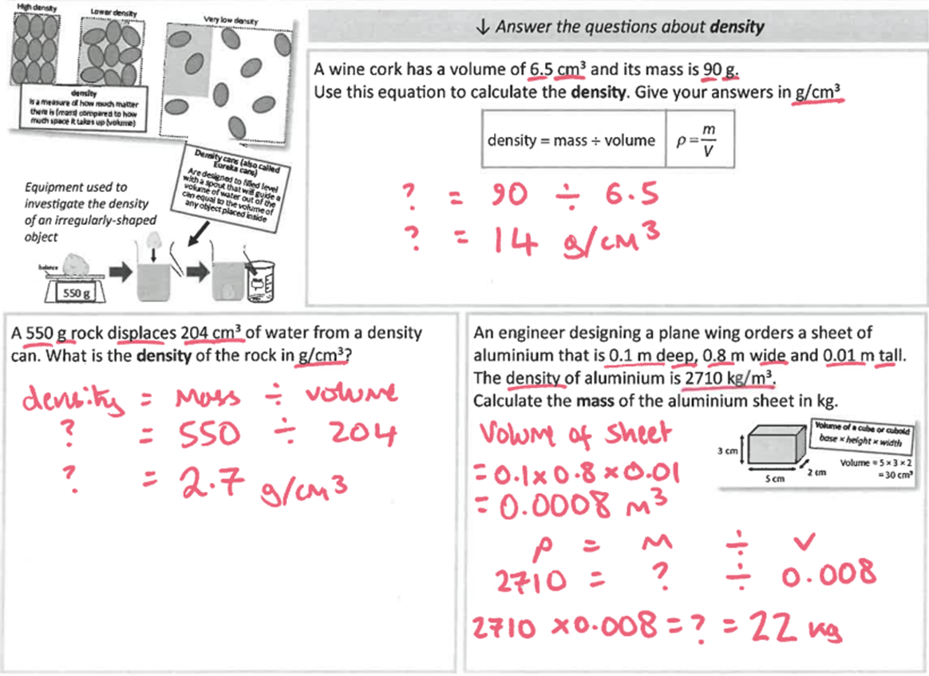
Section A
Fill in as much of section C and section D as you can.
Section B
A typical calculation from this topic
Section C
Section D
Extension task: Past paper
Click again for top of section D

Slide 10
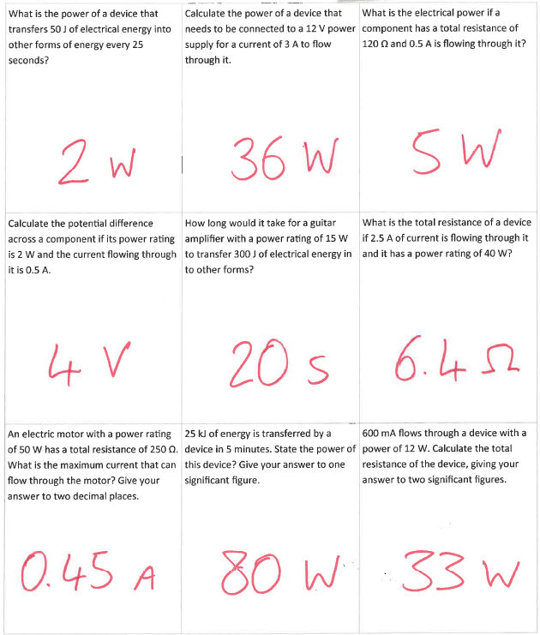
Section A
Fill in as much of section D as you can.
Section B
A typical calculation from this topic
Section C
Section D
Extension task: Past paper

