Slide 1
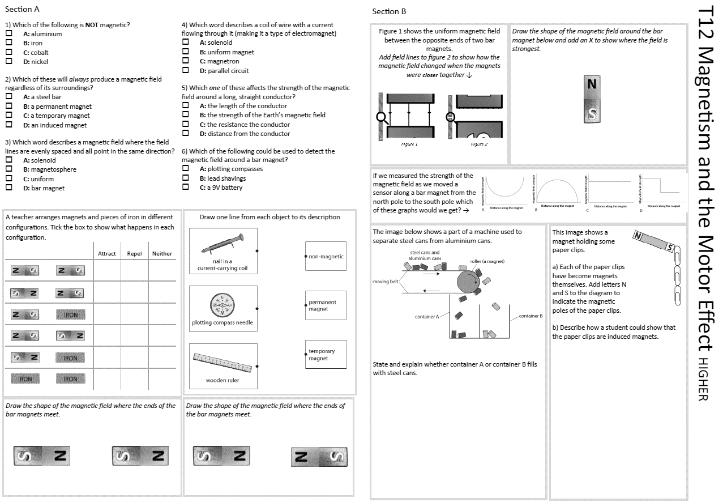
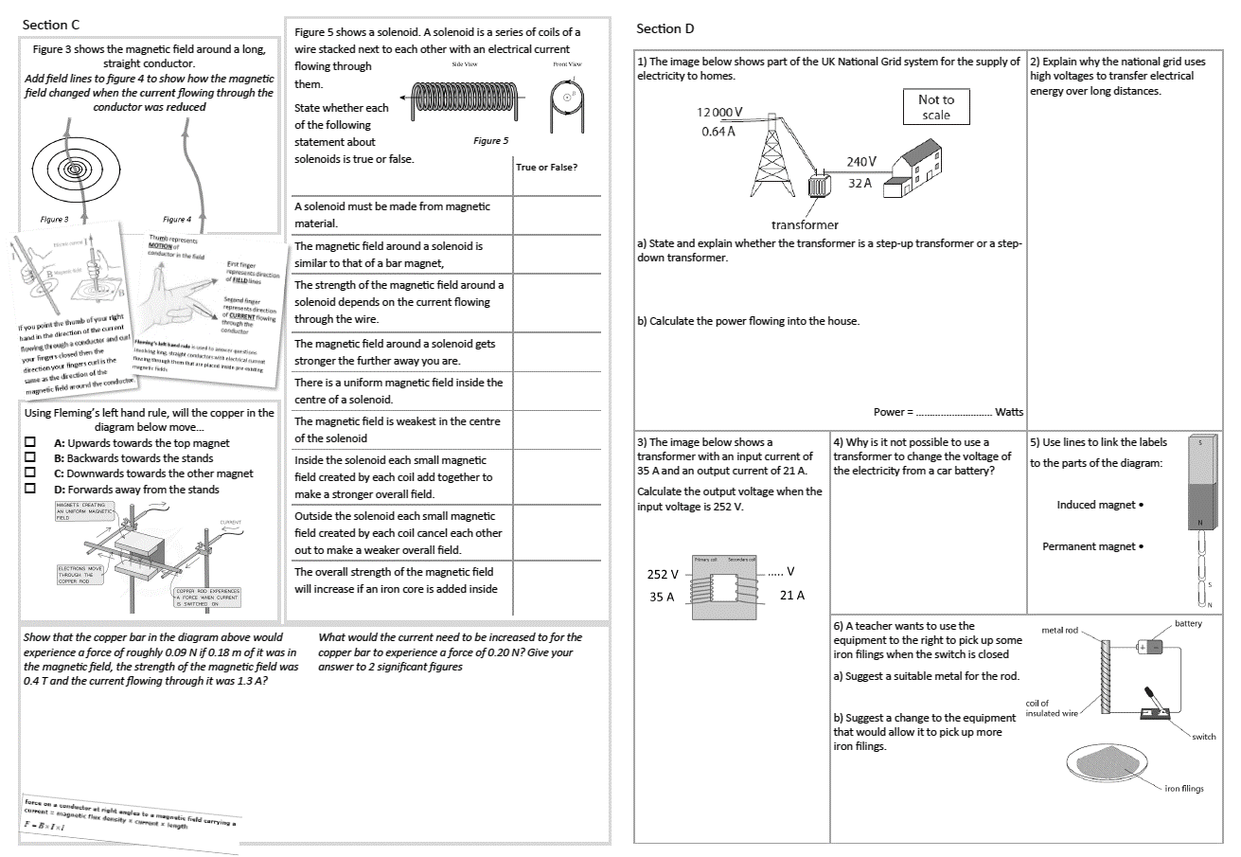
GCSE Physics Revision
Review Topic 12 and 13 (higher)
Magnetism and the Motor Effect, Electromagnetic Induction
Learning Outcomes
Identify core knowledge gaps within the topic.
Practise using equations related to the topic.
Collect an A3 revision mat
(← higher worksheet only - answers to the foundation tier worksheet are on a different set of slides)
And fill in as much of section A and section B as you can.

Slide 2
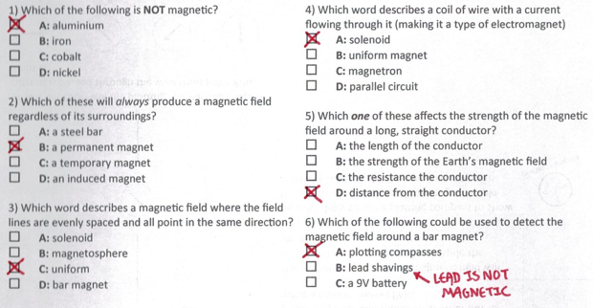
Section A
Collect an A3 revision mat (higher only)
And fill in as much of section A and section B as you can.
Section B
A typical calculation from this topic
Section C
Section D
Extension task: Past paper
Click again to show answers to section A multiple choice
Click again to show answers to section bottom half

Slide 3
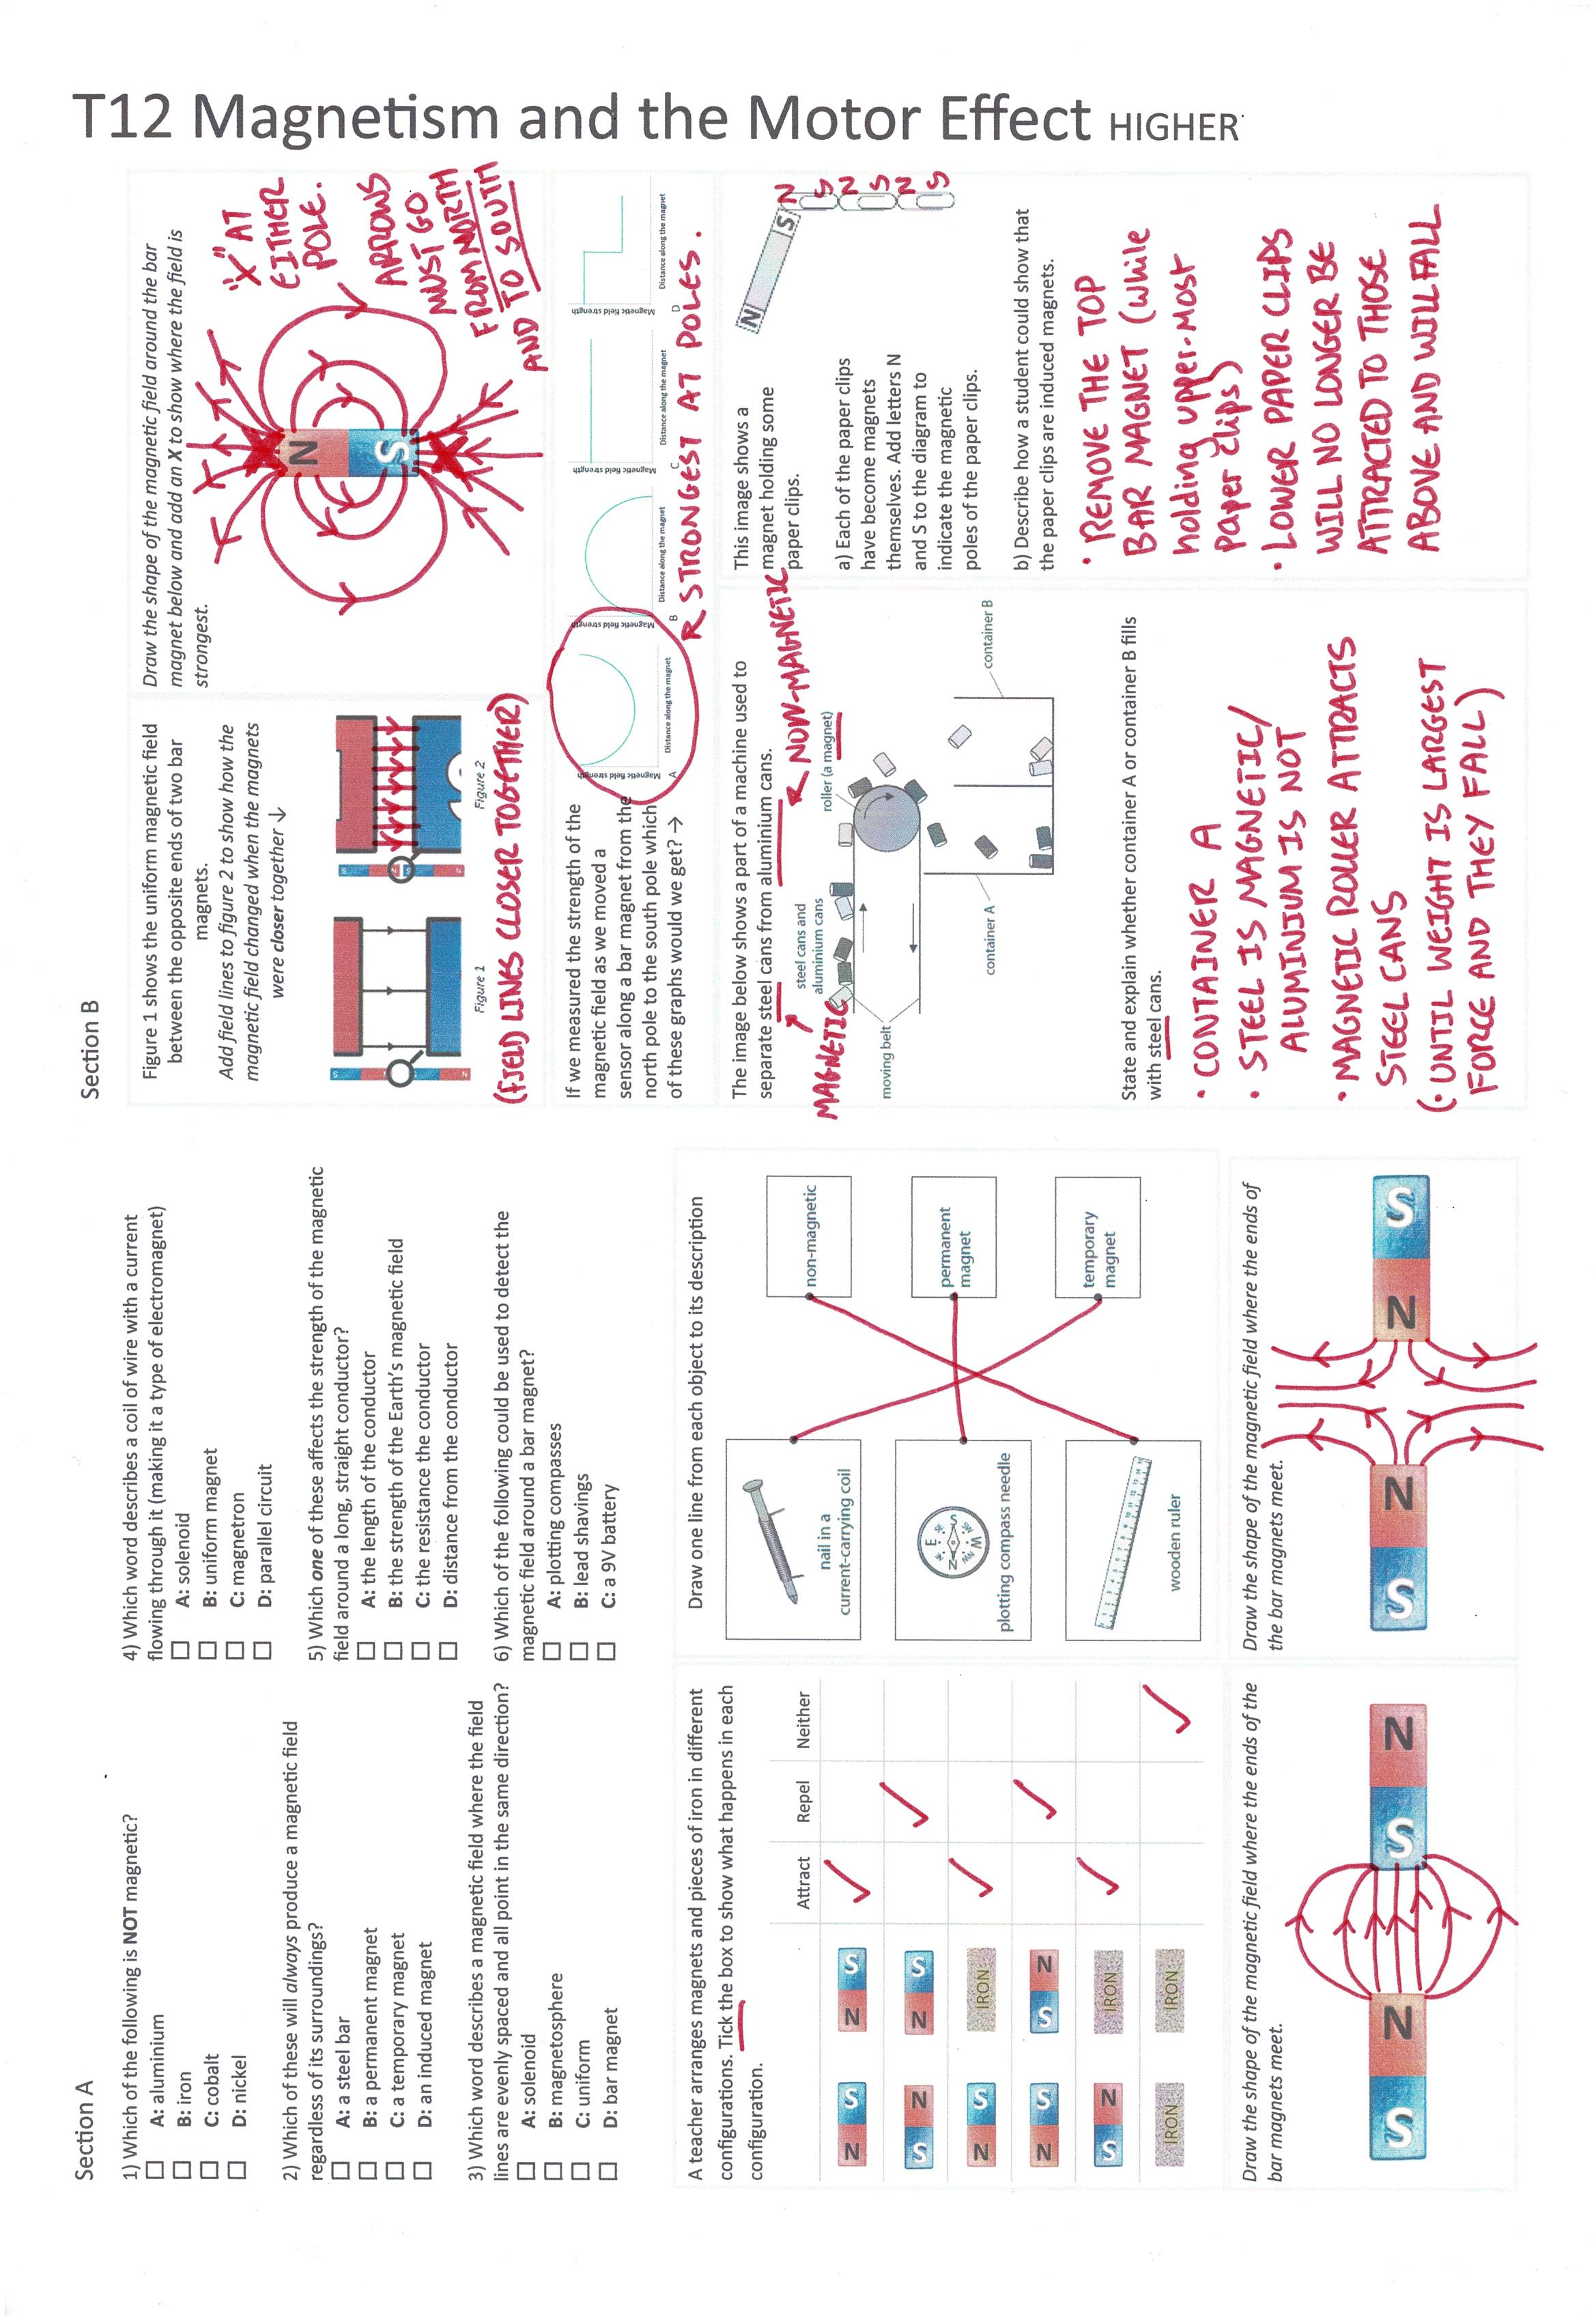

Section A
Fill in as much of section A and section B as you can.
Section B
A typical calculation from this topic
Section C
Section D
Extension task: Past paper
Click again to show answers to section B top half

Slide 4
Section A
Fill in as much of section A and section B as you can.
Section B
A typical calculation from this topic
Section C
Section D
Extension task: Past paper
Click again to show answers to section B bottom half

Slide 5
Section A
Section B
A typical calculation from this topic
Section C
Section D
Extension task: Past paper
Click again to show higher section B

Slide 6
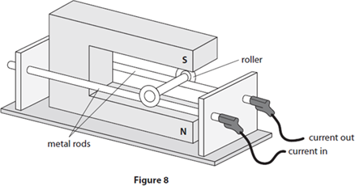
Section A
Section B
Figure 8 shows two metal rods carrying a current.
A metal roller touches both rods and completes the circuit.
The roller is in the magnetic field produced by a magnet.
The magnetic flux density of the magnetic field at the roller is 0.6 T.
The current in the roller is 2 A.
The length of the roller carrying the current is 8 cm.
Calculate the force on the roller.
Use the equation
F = B × I × l
A typical calculation from this topic
Section C
Section D
Extension task: Past paper
Force ……………………… N
Click again to show model answer

Slide 7
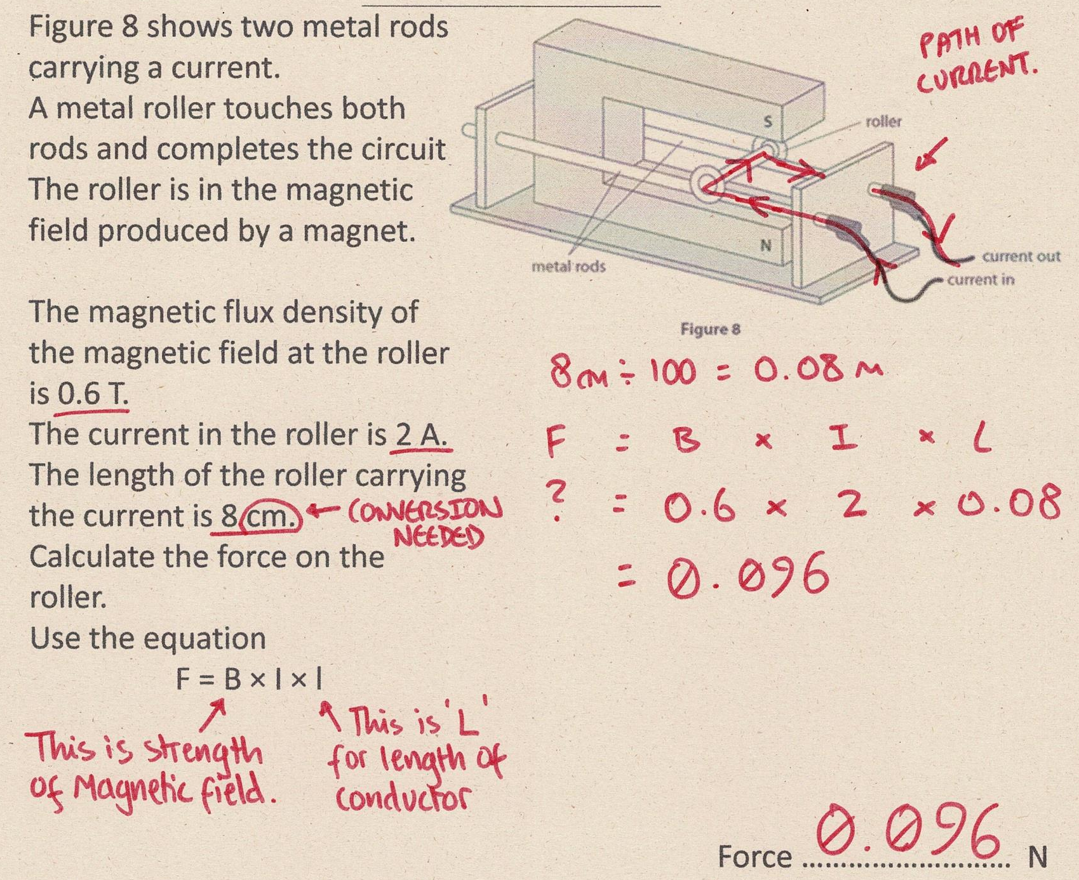
Section A
Fill in as much of section C and section D as you can.
Section B
A typical calculation from this topic
Section C
Section D
Extension task: Past paper
Click again to show answers to section C top half

Slide 8
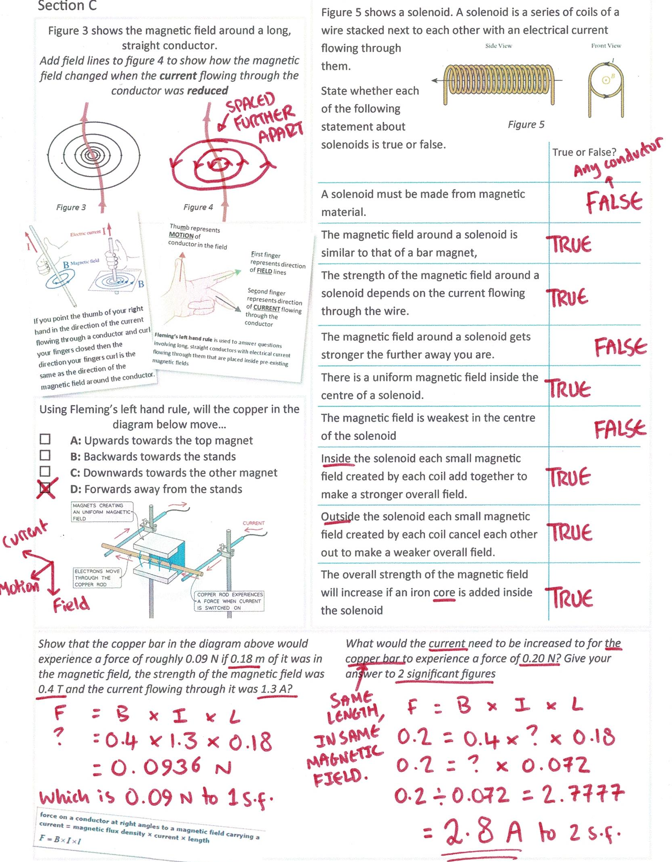
Section A
Fill in as much of section C and section D as you can.
Section B
A typical calculation from this topic
Section C
Section D
Extension task: Past paper
Click again for top of section D

Slide 9
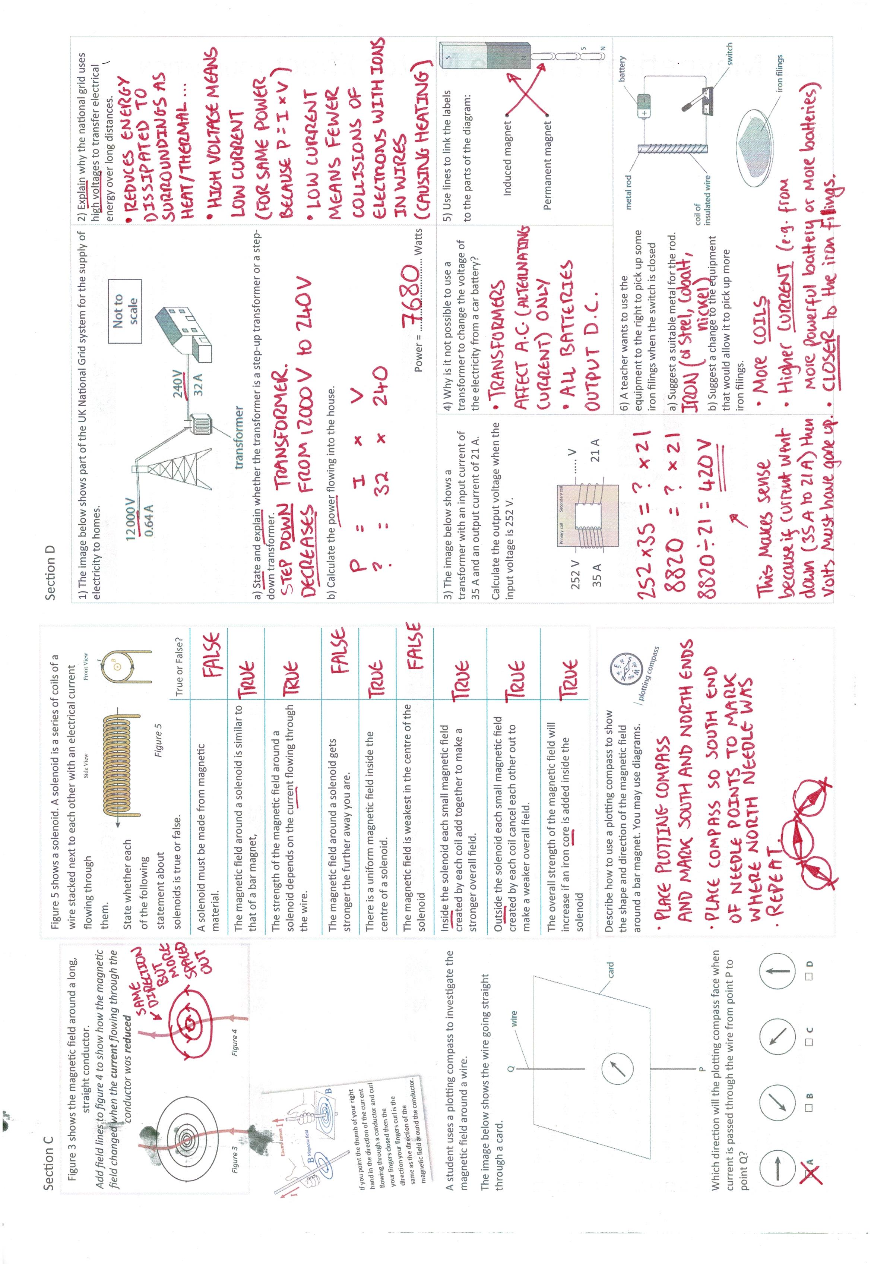
Section A
Fill in as much of section D as you can.
Section B
A typical calculation from this topic
Section C
Section D
Extension task: Past paper

Slide 10
Section A
Fill in as much of section D as you can.
Section B
A typical calculation from this topic
Section C
Section D
Extension task: Past paper

