Slide 1
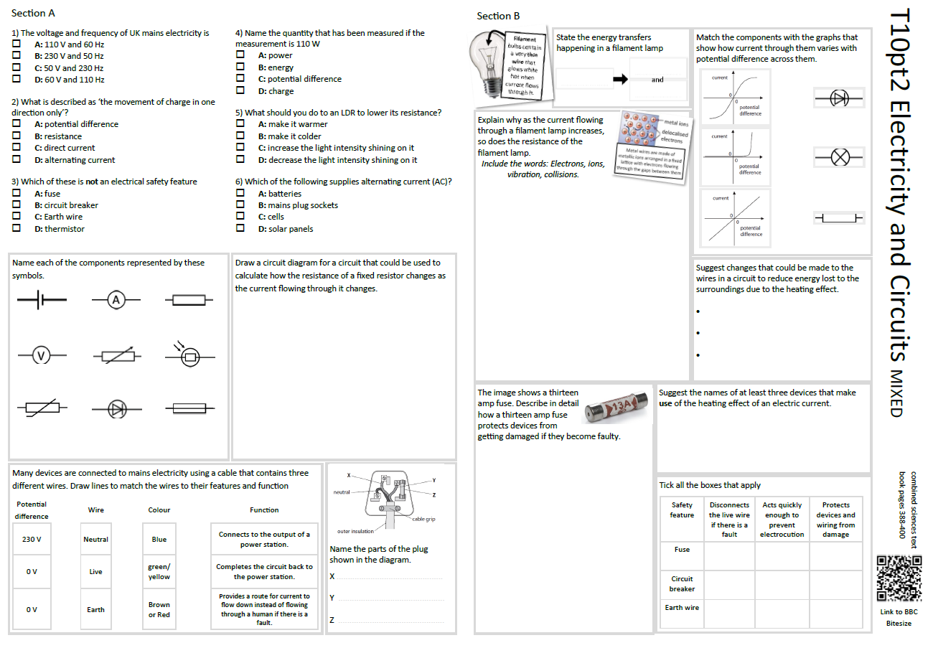
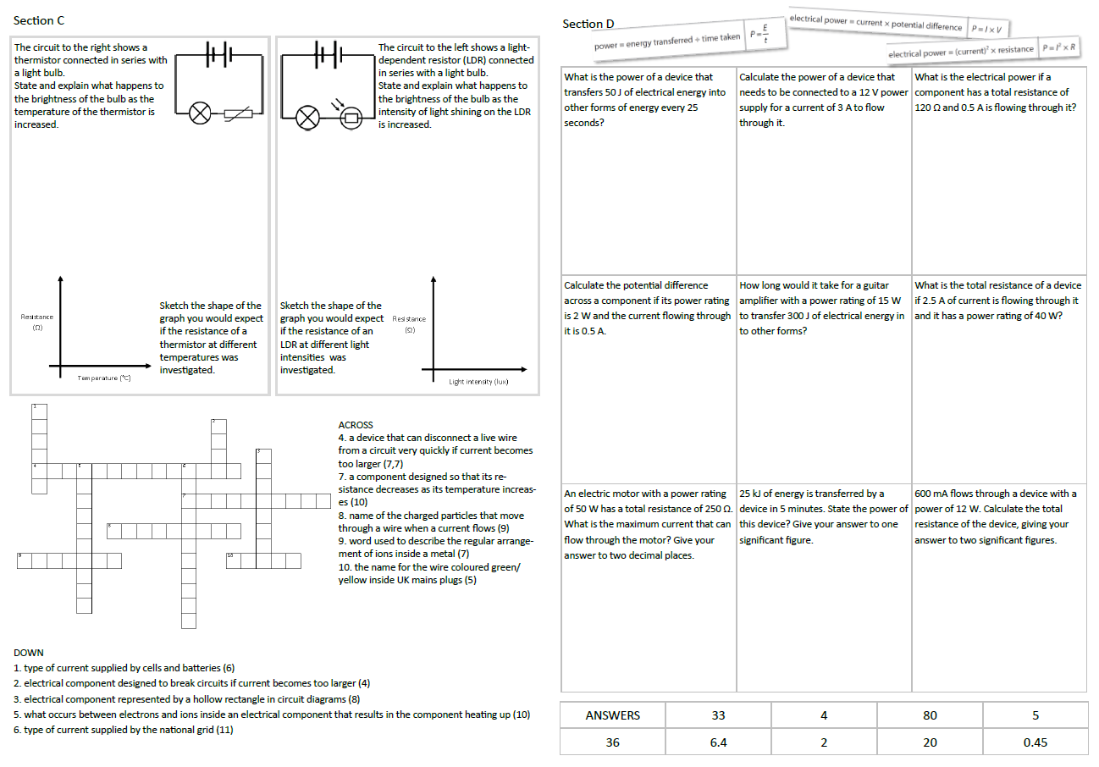
GCSE Physics Revision
Review Topic 10 pt2
Electricity and Circuits
Learning Outcomes
Identify core knowledge gaps within the topic.
Practise using equations related to the topic.
Collect an A3 revision mat
(← mixed tiers - no difference for foundation or higher)
And fill in as much of section A and section B as you can.

Slide 2
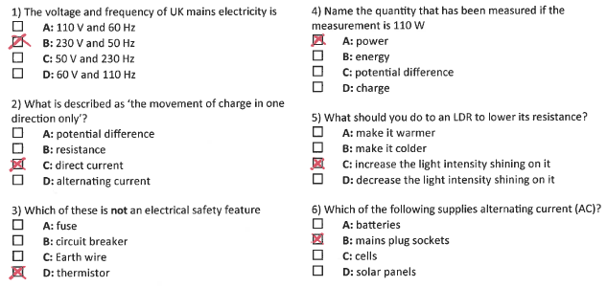
Section A
Collect an A3 revision mat (mixed tiers - higher and foundation pick up the same one)
And fill in as much of section A and section B as you can.
Section B
A typical calculation from this topic
Section C
Section D
Extension task: Past paper
Click again to show answers to section A multiple choice
Click again to show answers to section bottom half

Slide 3

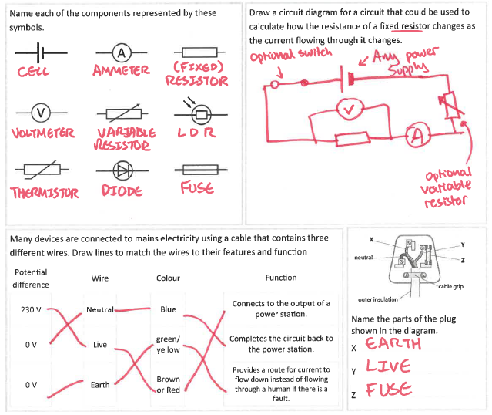
Section A
Fill in as much of section A and section B as you can.
Section B
A typical calculation from this topic
Section C
Section D
Extension task: Past paper
Click again to show answers to section B top half

Slide 4
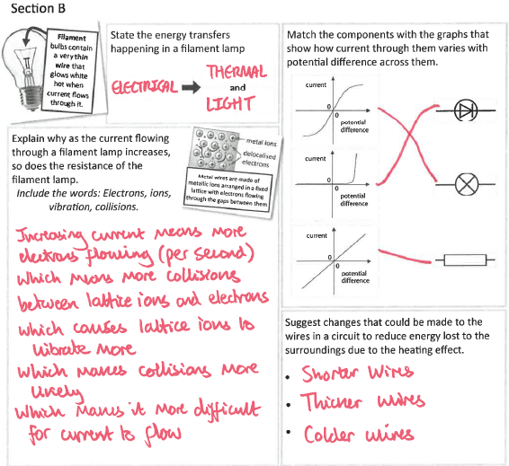
Section A
Fill in as much of section A and section B as you can.
Section B
A typical calculation from this topic
Section C
Section D
Extension task: Past paper
Click again to show answers to section B bottom half

Slide 5
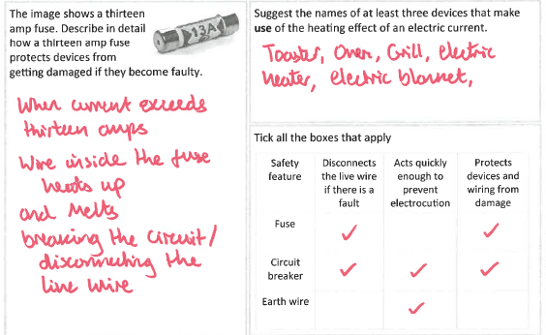
Section A
Section B
A typical calculation from this topic
Section C
Section D
Extension task: Past paper
Click again to show higher section B

Slide 6
Section A
Section B
A kettle has a power rating of 2 kW. It is connected to a 240 V mains power supply.
How much charge flows through the kettle in 30 seconds?
Use equations found on the equation sheet provided.
(4 marks)
A typical calculation from this topic
Section C
Section D
Extension task: Past paper
charge ……………………… C
Click again to show model answer

Slide 7
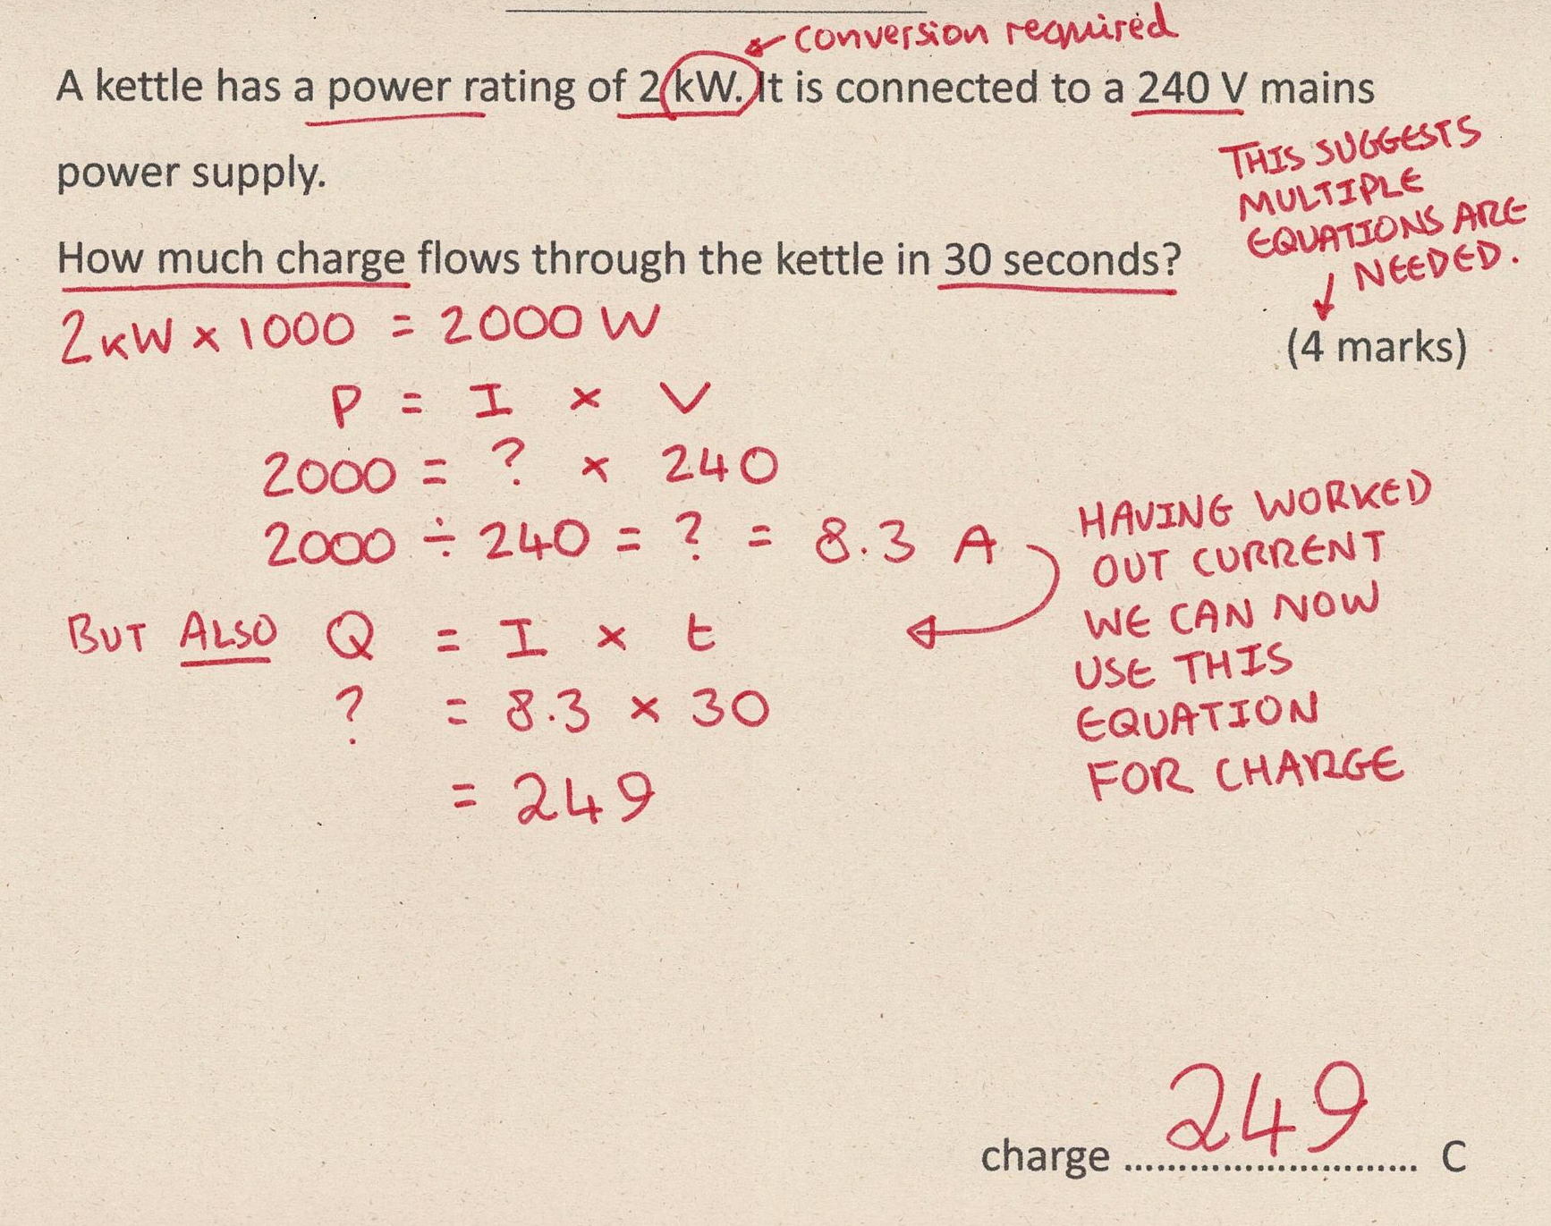
Section A
Fill in as much of section C and section D as you can.
Section B
A typical calculation from this topic
Section C
Section D
Extension task: Past paper
Click again to show answers to section C top half

Slide 8
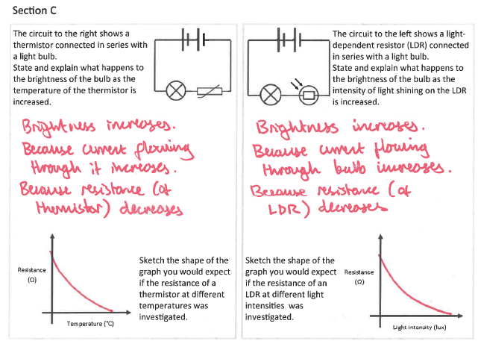
Section A
Fill in as much of section C and section D as you can.
Section B
A typical calculation from this topic
Section C
Section D
Extension task: Past paper
Click again to show answers to section C top half

Slide 9
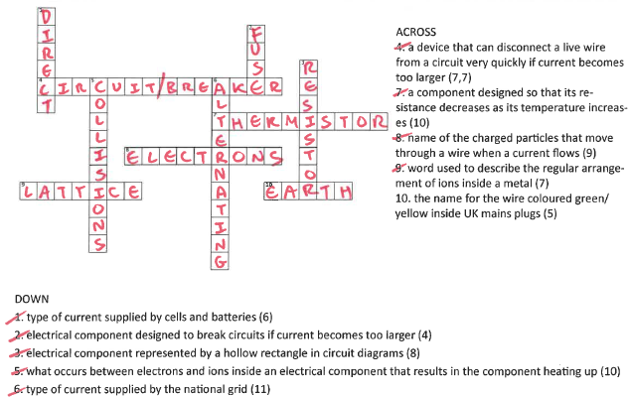
Section A
Fill in as much of section C and section D as you can.
Section B
A typical calculation from this topic
Section C
Section D
Extension task: Past paper
Click again for top of section D

Slide 10
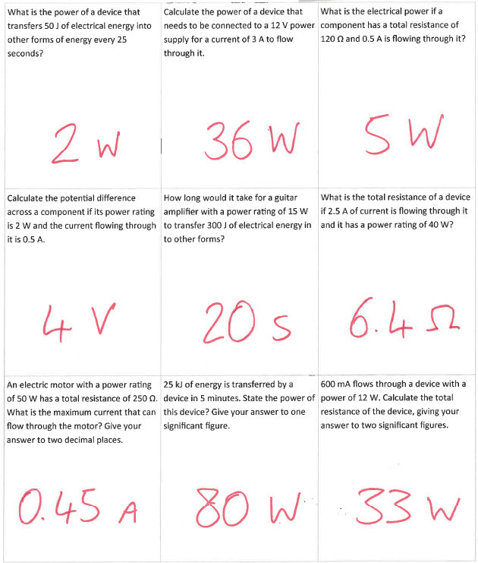
Section A
Fill in as much of section D as you can.
Section B
A typical calculation from this topic
Section C
Section D
Extension task: Past paper

