Slide 1
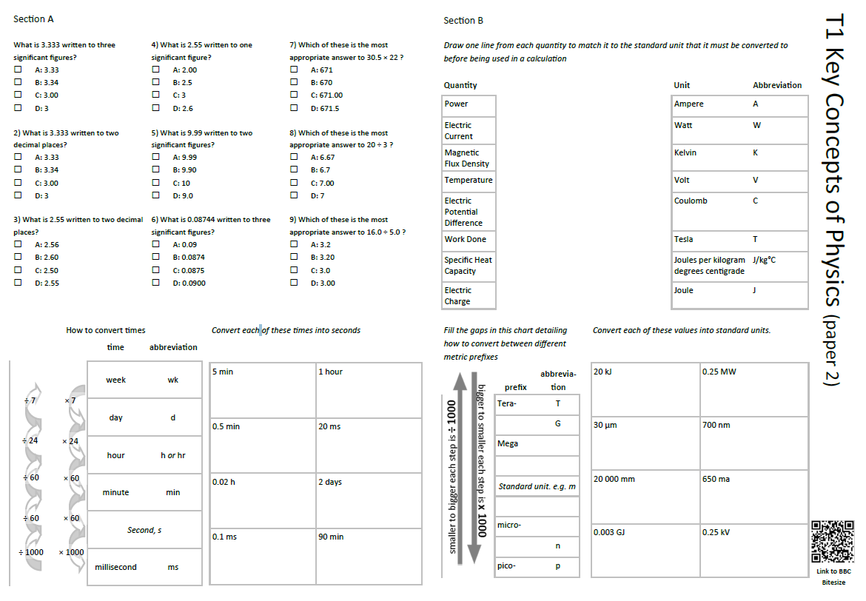
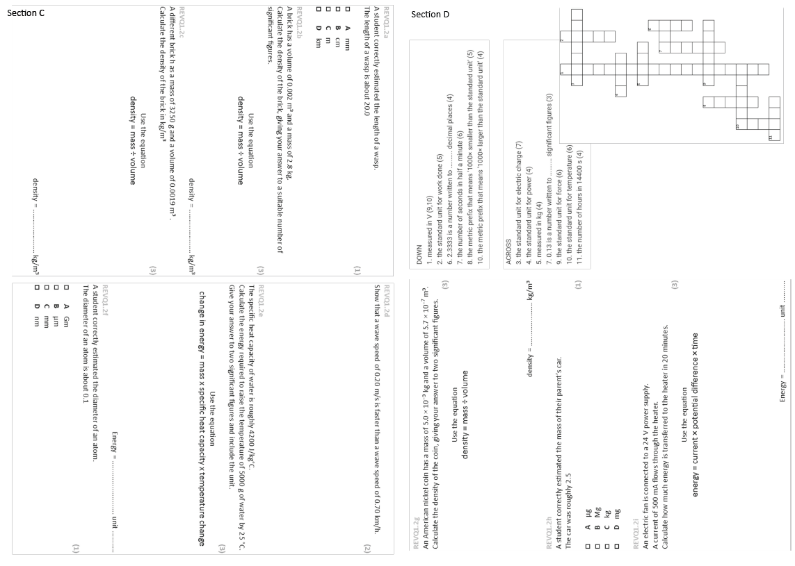
GCSE Physics Revision
Review Topic 1
Key Concepts of Physics
Learning Outcomes
Identify core knowledge gaps within the topic.
Practise using equations related to the topic.
Collect an A3 revision mat
(← mixed tiers - no difference for foundation or higher)
And fill in as much of section A and section B as you can.

Slide 2
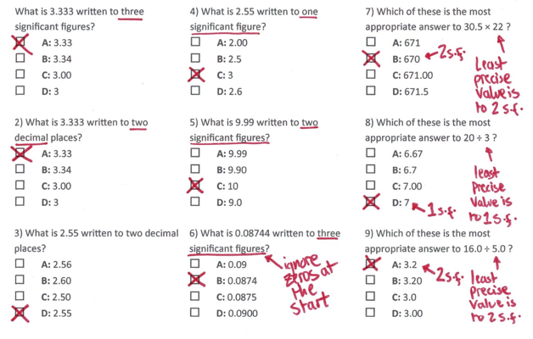
Section A
Collect an A3 revision mat (foundation only)
And fill in as much of section A and section B as you can.
Section B
A typical calculation from this topic
Section C
Section D
Extension task: Past paper
Click again to show answers to section A multiple choice
Click again to show answers to section bottom half

Slide 3

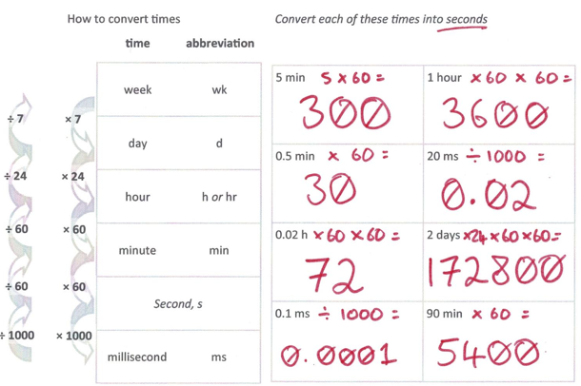
Section A
Fill in as much of section A and section B as you can.
Section B
A typical calculation from this topic
Section C
Section D
Extension task: Past paper
Click again to show answers to section B top half

Slide 4
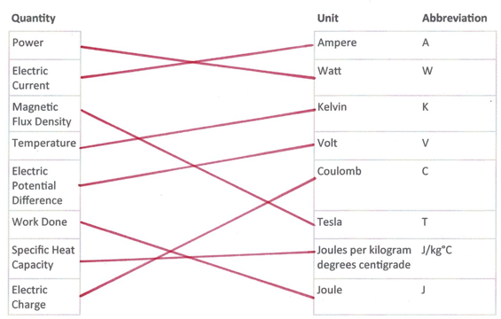
Section A
Fill in as much of section A and section B as you can.
Section B
A typical calculation from this topic
Section C
Section D
Extension task: Past paper
Click again to show answers to section B bottom half

Slide 5
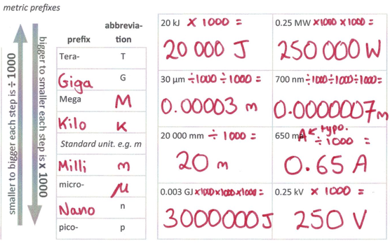
Section A
Section B
A typical calculation from this topic
Section C
Section D
Extension task: Past paper
Click again to show equations to model answering

Slide 6
Section A
Section B
Show that 60 km/h is a slower speed than 18 m/s
(3 marks)
A typical calculation from this topic
Section C
Section D
Extension task: Past paper
Click again to show worked answer

Slide 7
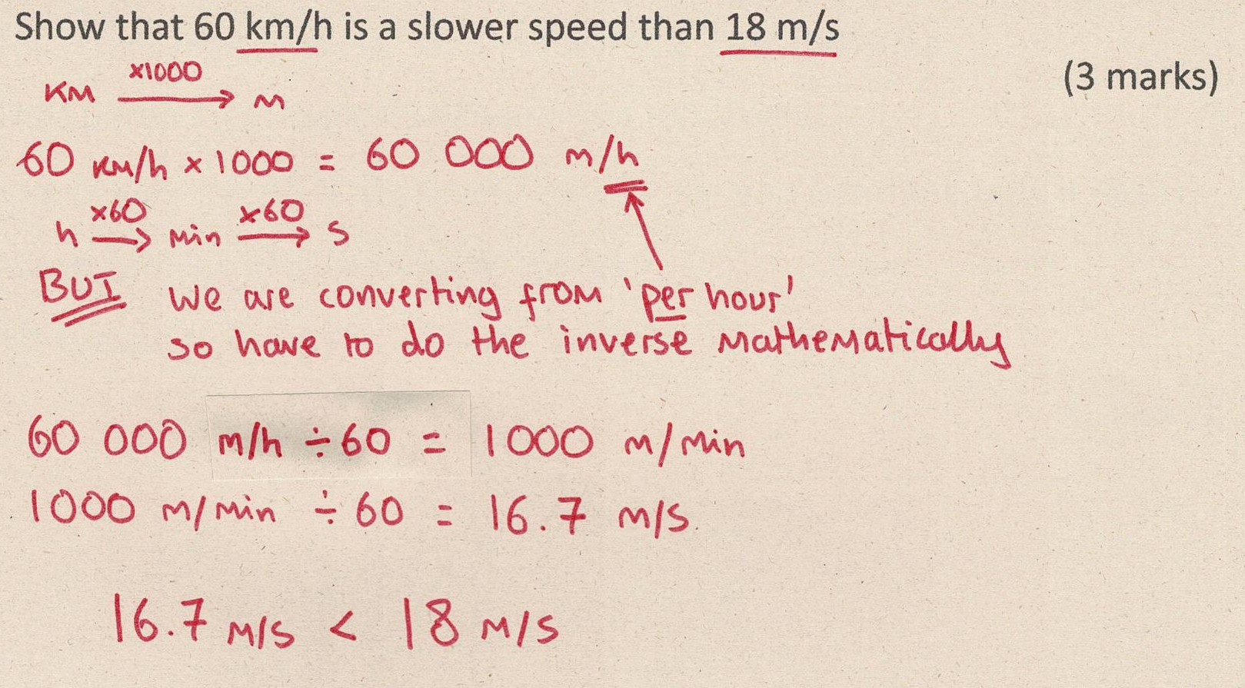
Section A
Fill in as much of section C and section D as you can.
Section B
A typical calculation from this topic
Section C
Section D
Extension task: Past paper
Click again to show answers to section C top half

Slide 8
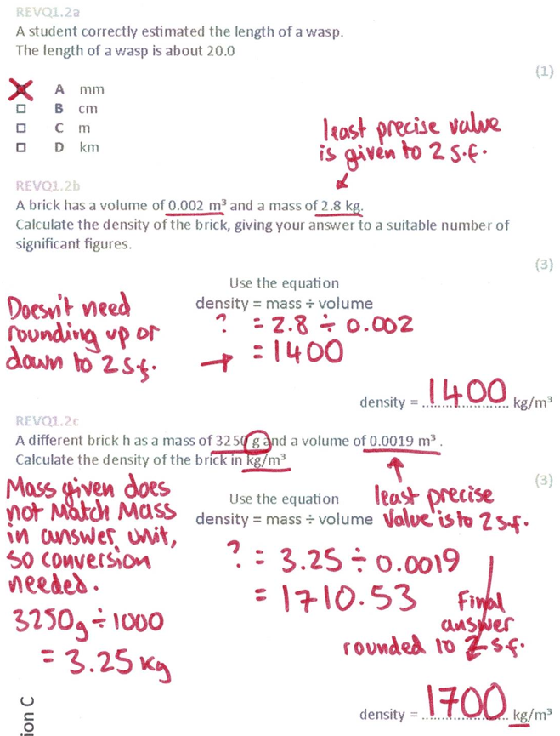
Section A
Fill in as much of section C and section D as you can.
Section B
A typical calculation from this topic
Section C
Section D
Extension task: Past paper
Click again to show answers to section C bottom half

Slide 9
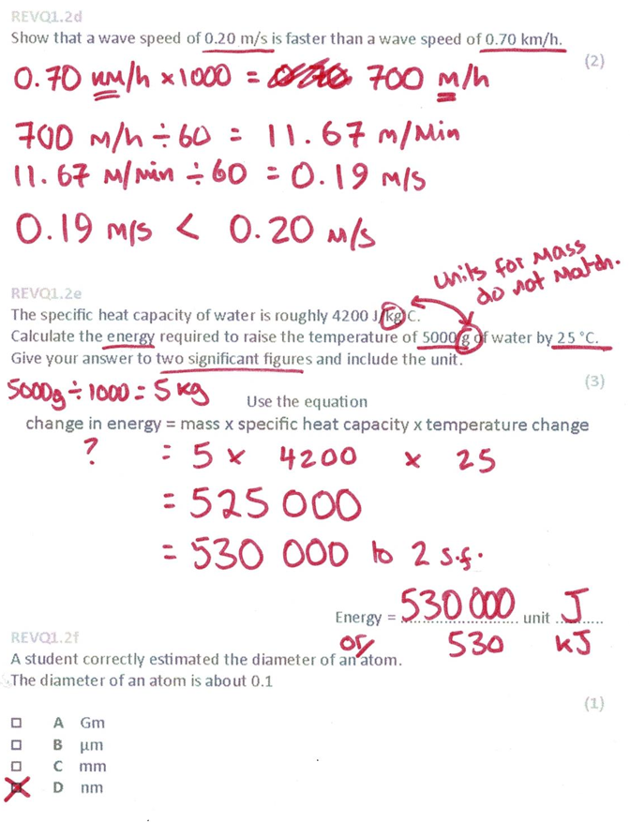
Section A
Fill in as much of section C and section D as you can.
Section B
A typical calculation from this topic
Section C
Section D
Extension task: Past paper
Click again for top of section D

Slide 10
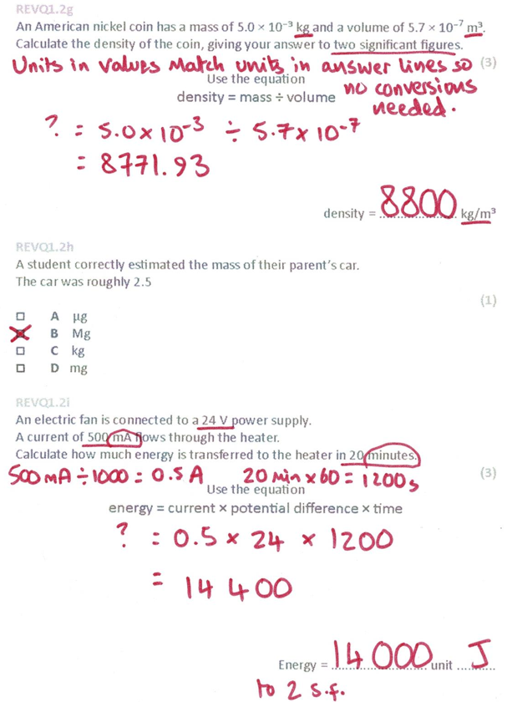
Section A
Fill in as much of section C and section D as you can.
Section B
A typical calculation from this topic
Section C
Section D
Extension task: Past paper
END

Slide 11
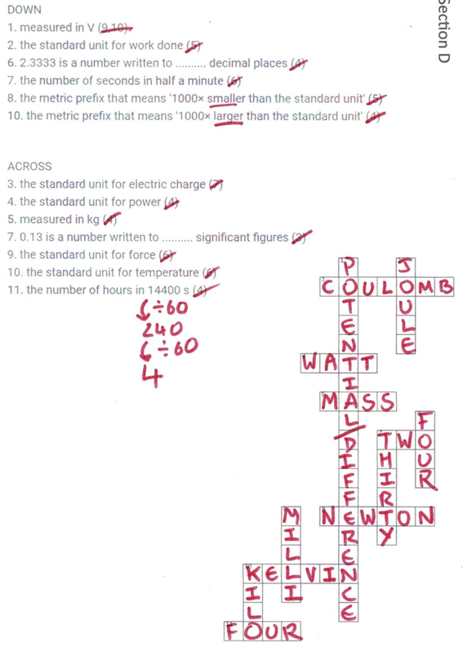
Section A
Fill in as much of section C and section D as you can.
Section B
A typical calculation from this topic
Section C
Section D
Extension task: Past paper
END

